Slide 1
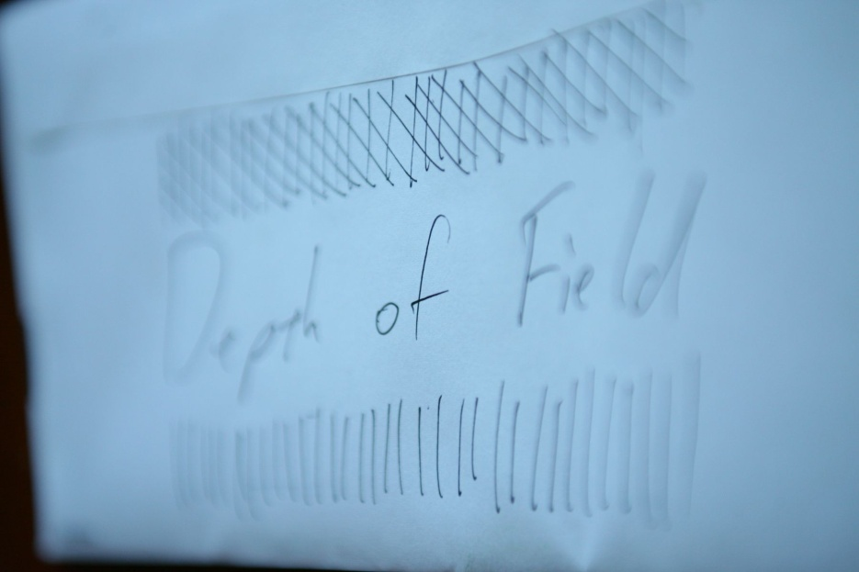

Slide 2
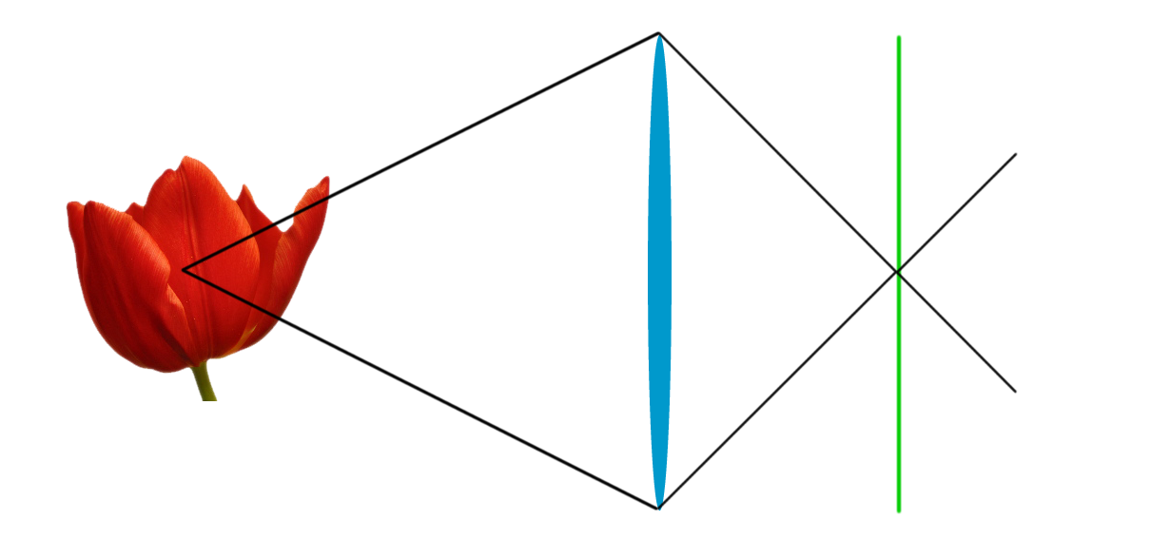
Focusing
A look at the overall camera system
Lens
Bends the light
Film/Sensor
Where the light is recorded
Subject
Source of light
Trajectory of light

Slide 3
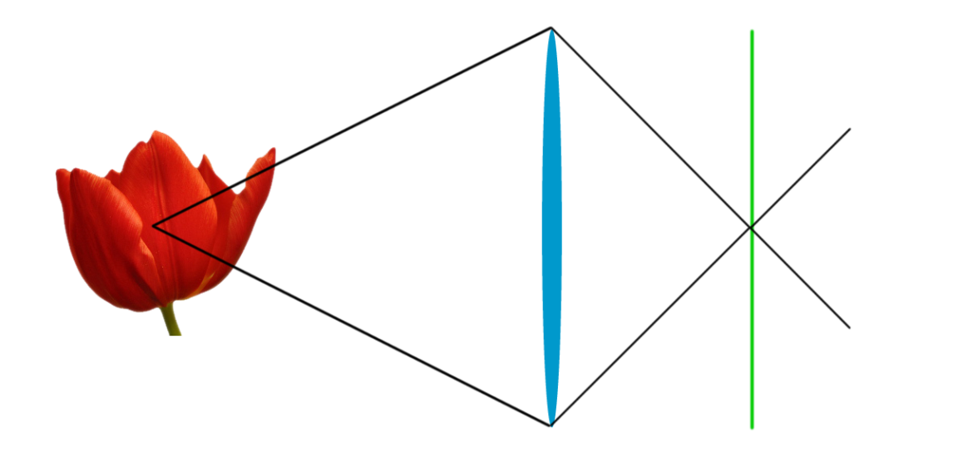
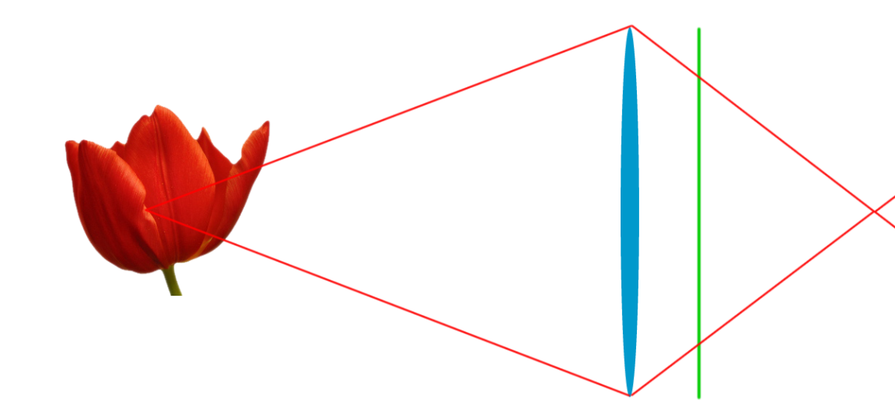
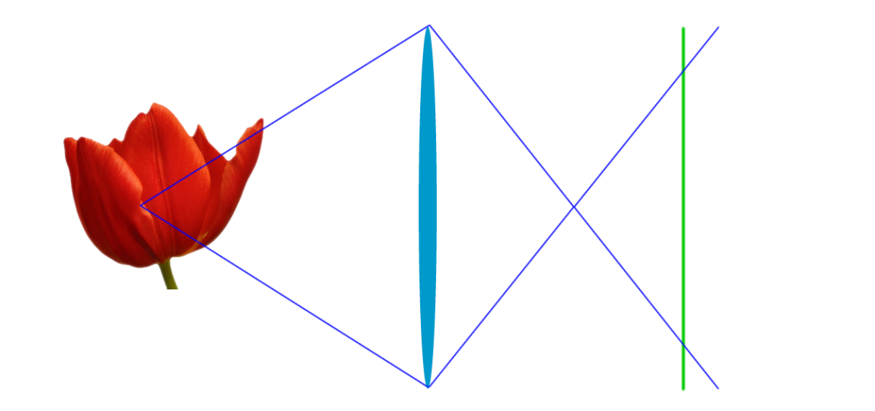
Result:
Light converges at sensor
‘In focus’
Light converges past sensor
‘Out of focus’
Light converges before sensor
‘Out of focus’

Slide 4
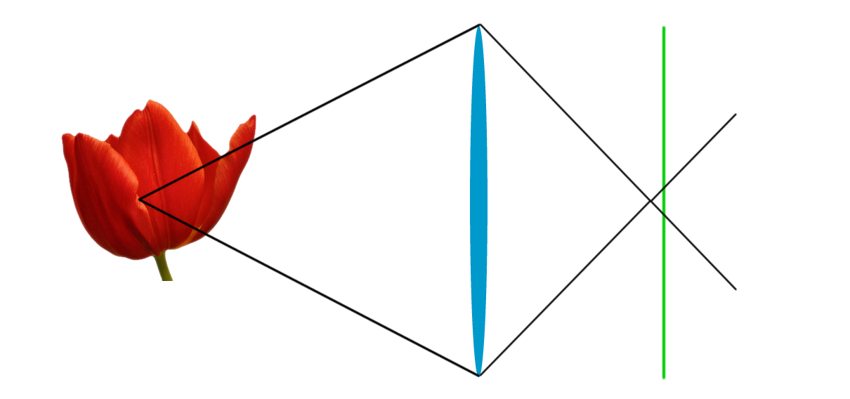
Result:
‘In focus’
Circle of confusion
Image doesn’t have to perfectly converge. If it converges within a “circle of confusion”, it is still ‘in focus’
‘In focus’
‘Out of focus’

Slide 5
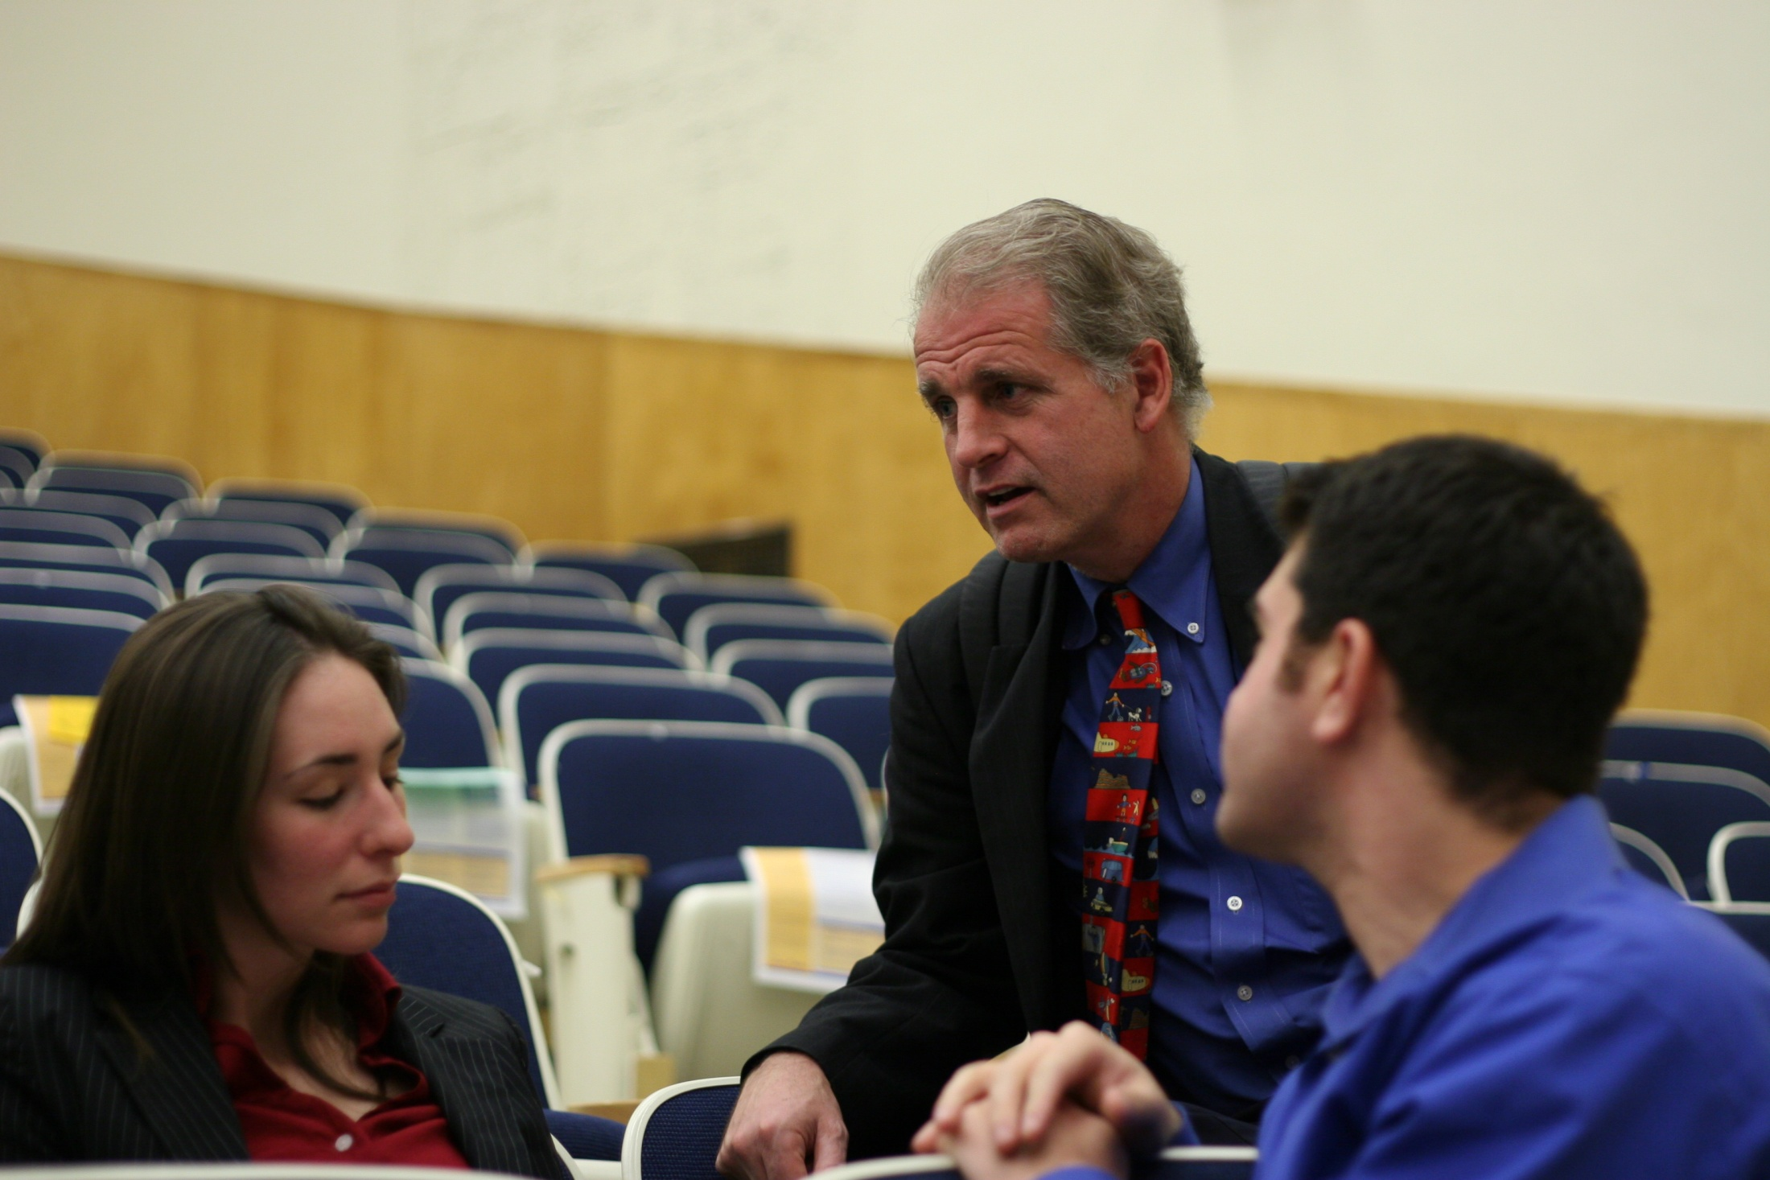
In focus
Out of focus
Out of focus

Slide 6
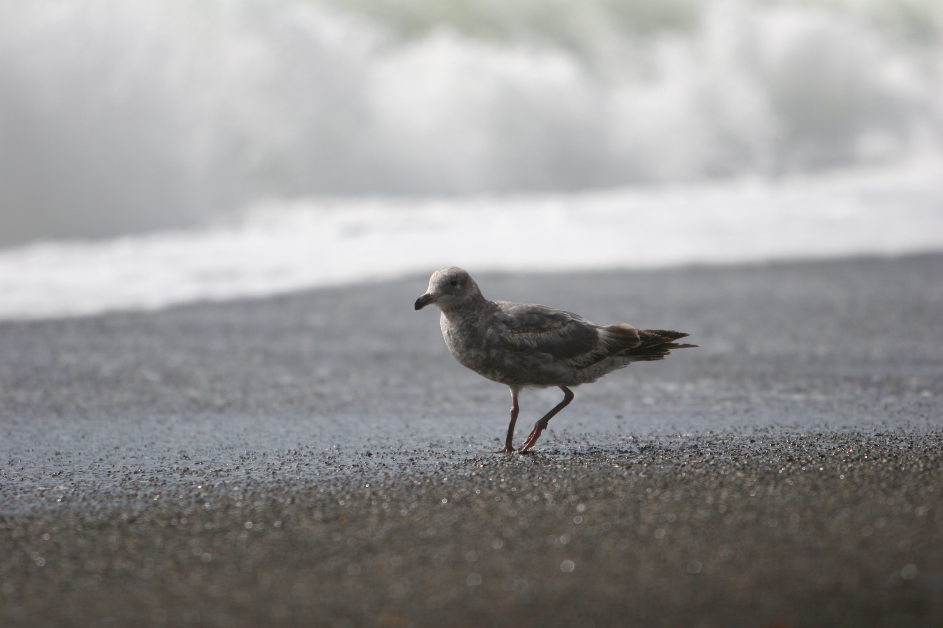
Things at a certain distance are “in focus” (perfectly sharp)
The further from this distance, the blurrier things are
There is a range of distance where things are ‘sharp enough’ to be considered ‘in focus’. This range is known as the “depth of field”
Depth of field
Amount of Blur

Slide 7
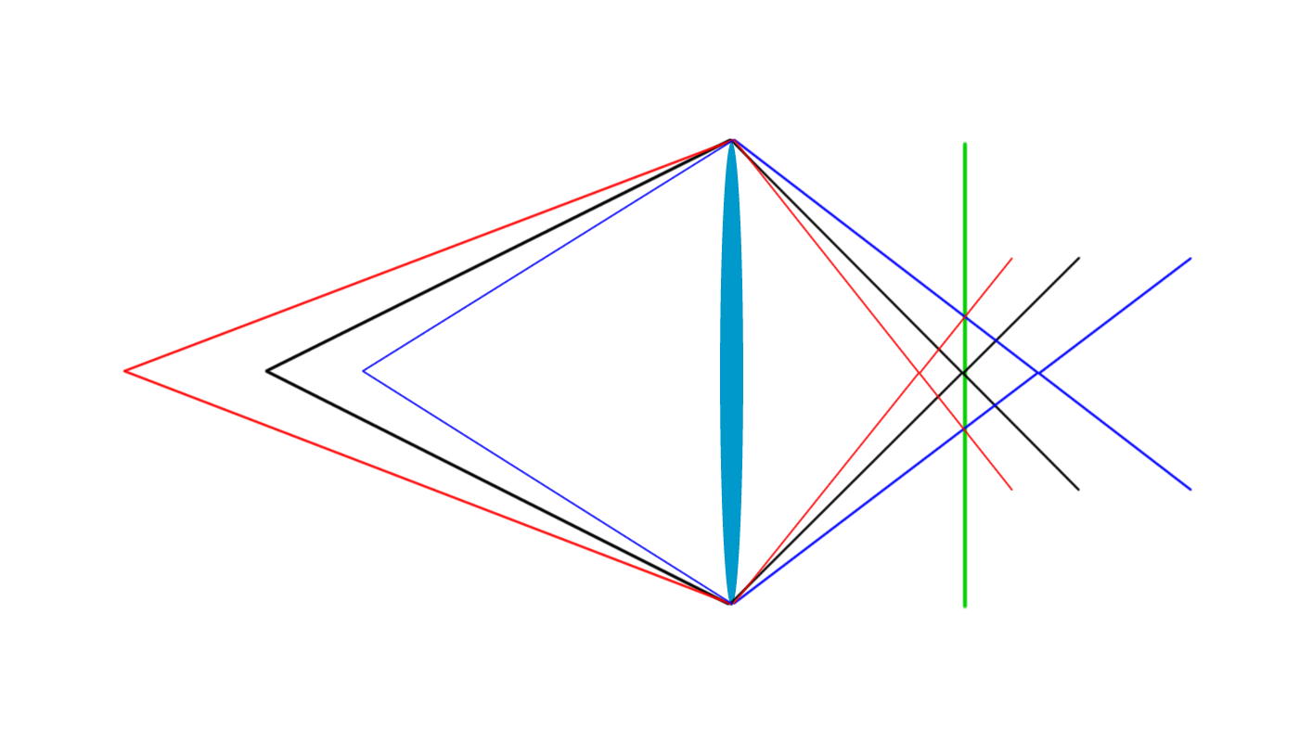
Depth of field
Range that is ‘in focus’
Film/Sensor
Where the light is recorded
Circle of confusion
Maximum non-convergance allowed to be ‘in focus’
Far limit of focus
Near limit of focus
Focus point

Slide 8
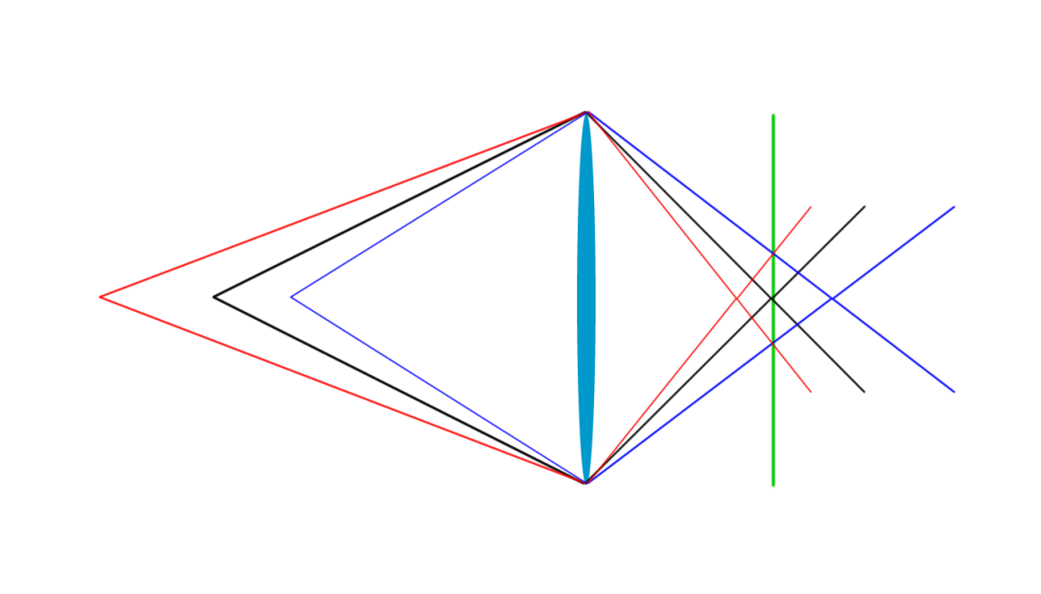
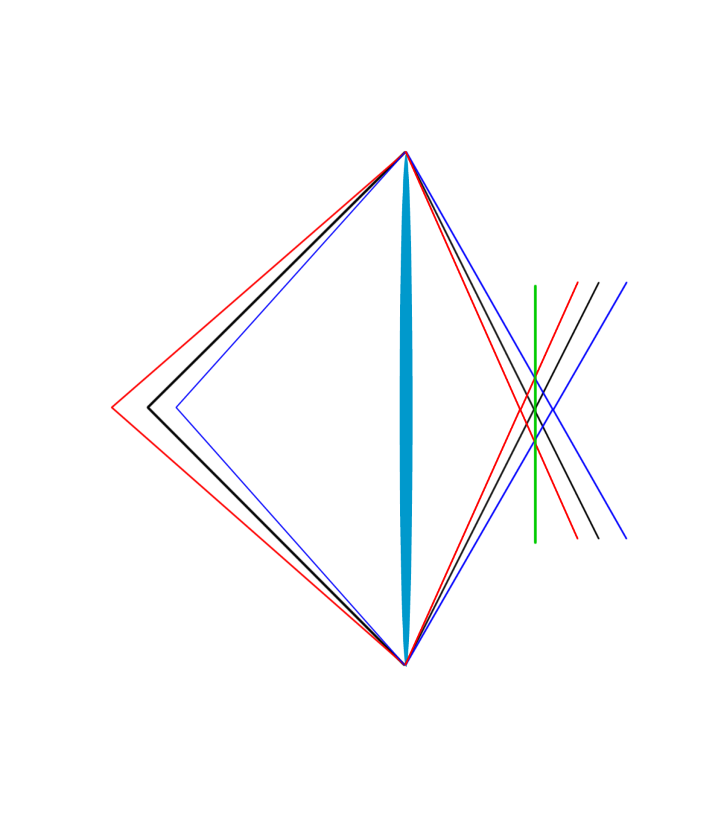
Depth of field
Circle of confusion
When using a bigger lens (larger aperture), the depth of field shrinks

Slide 9
Depth of field
Circle of confusion
Longer subject distances mean larger depth of field range

Slide 10
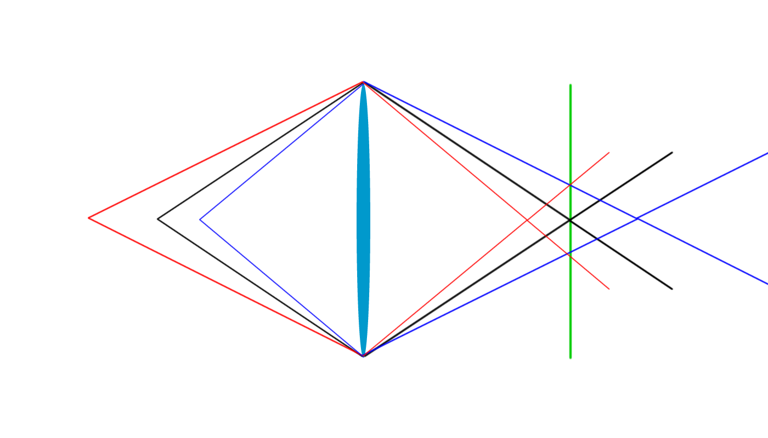
Depth of field
Circle of confusion
Longer focal lengths mean smaller depth of field range

Slide 11
A = aperture f-number (e.g. f5.6)
f = focal length (e.g. 50mm)
d = distance to subject (e.g. 3000mm)
c = circle of confusion (e.g. .02mm)
Factors to note:
Smaller apertures (larger f-number) gives larger depth of field
Shorter focal length gives larger depth of field
Longer distance to subject gives larger depth of field
Larger circle of confusion gives larger depth of field

Slide 12
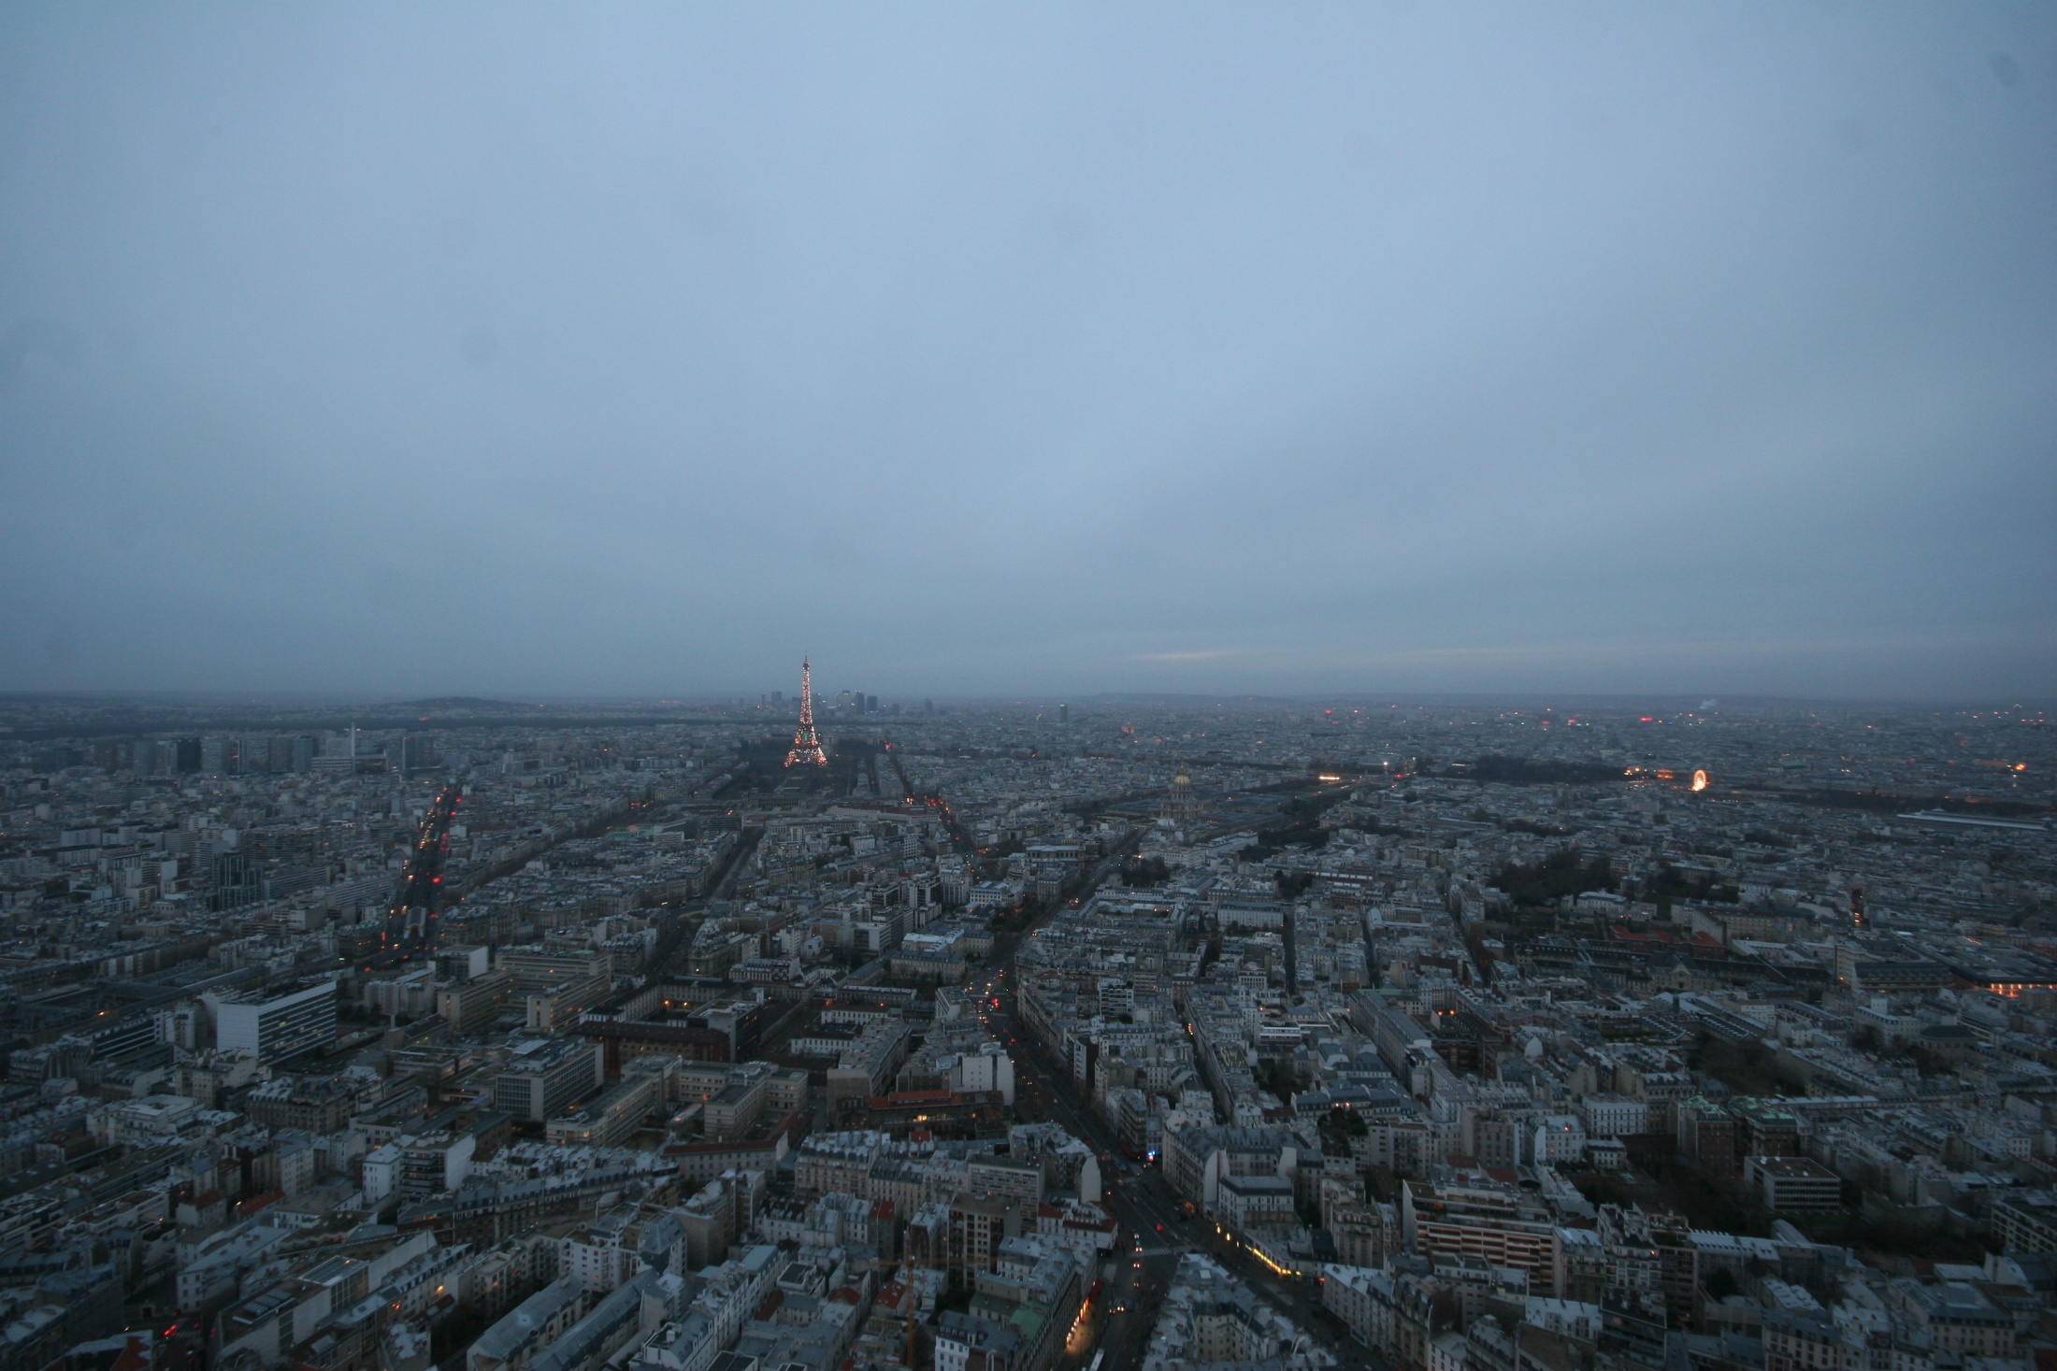
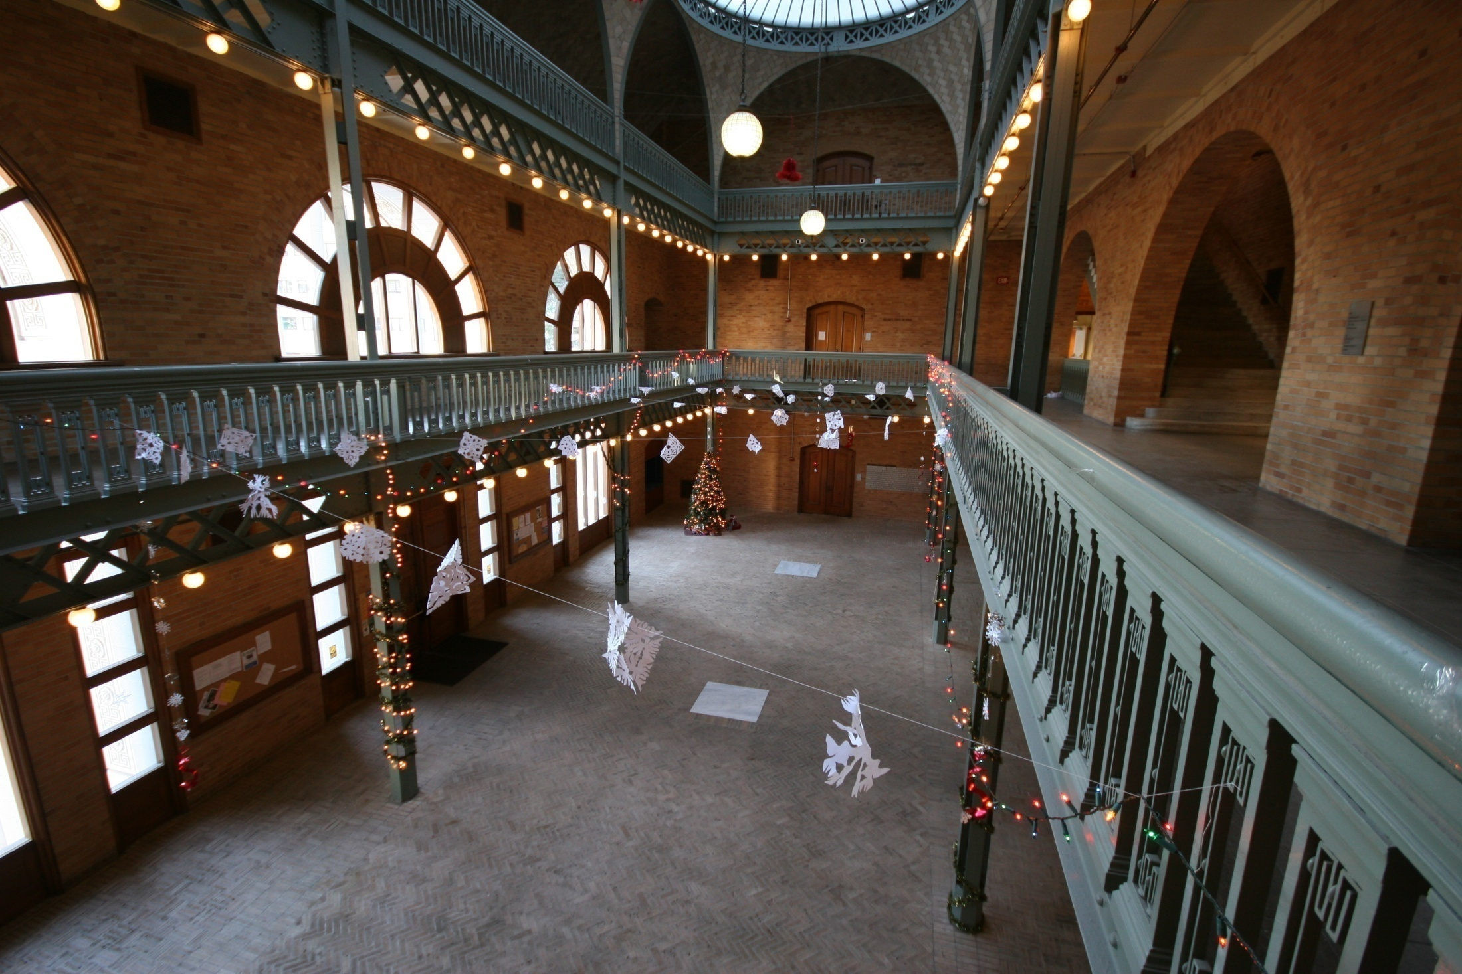
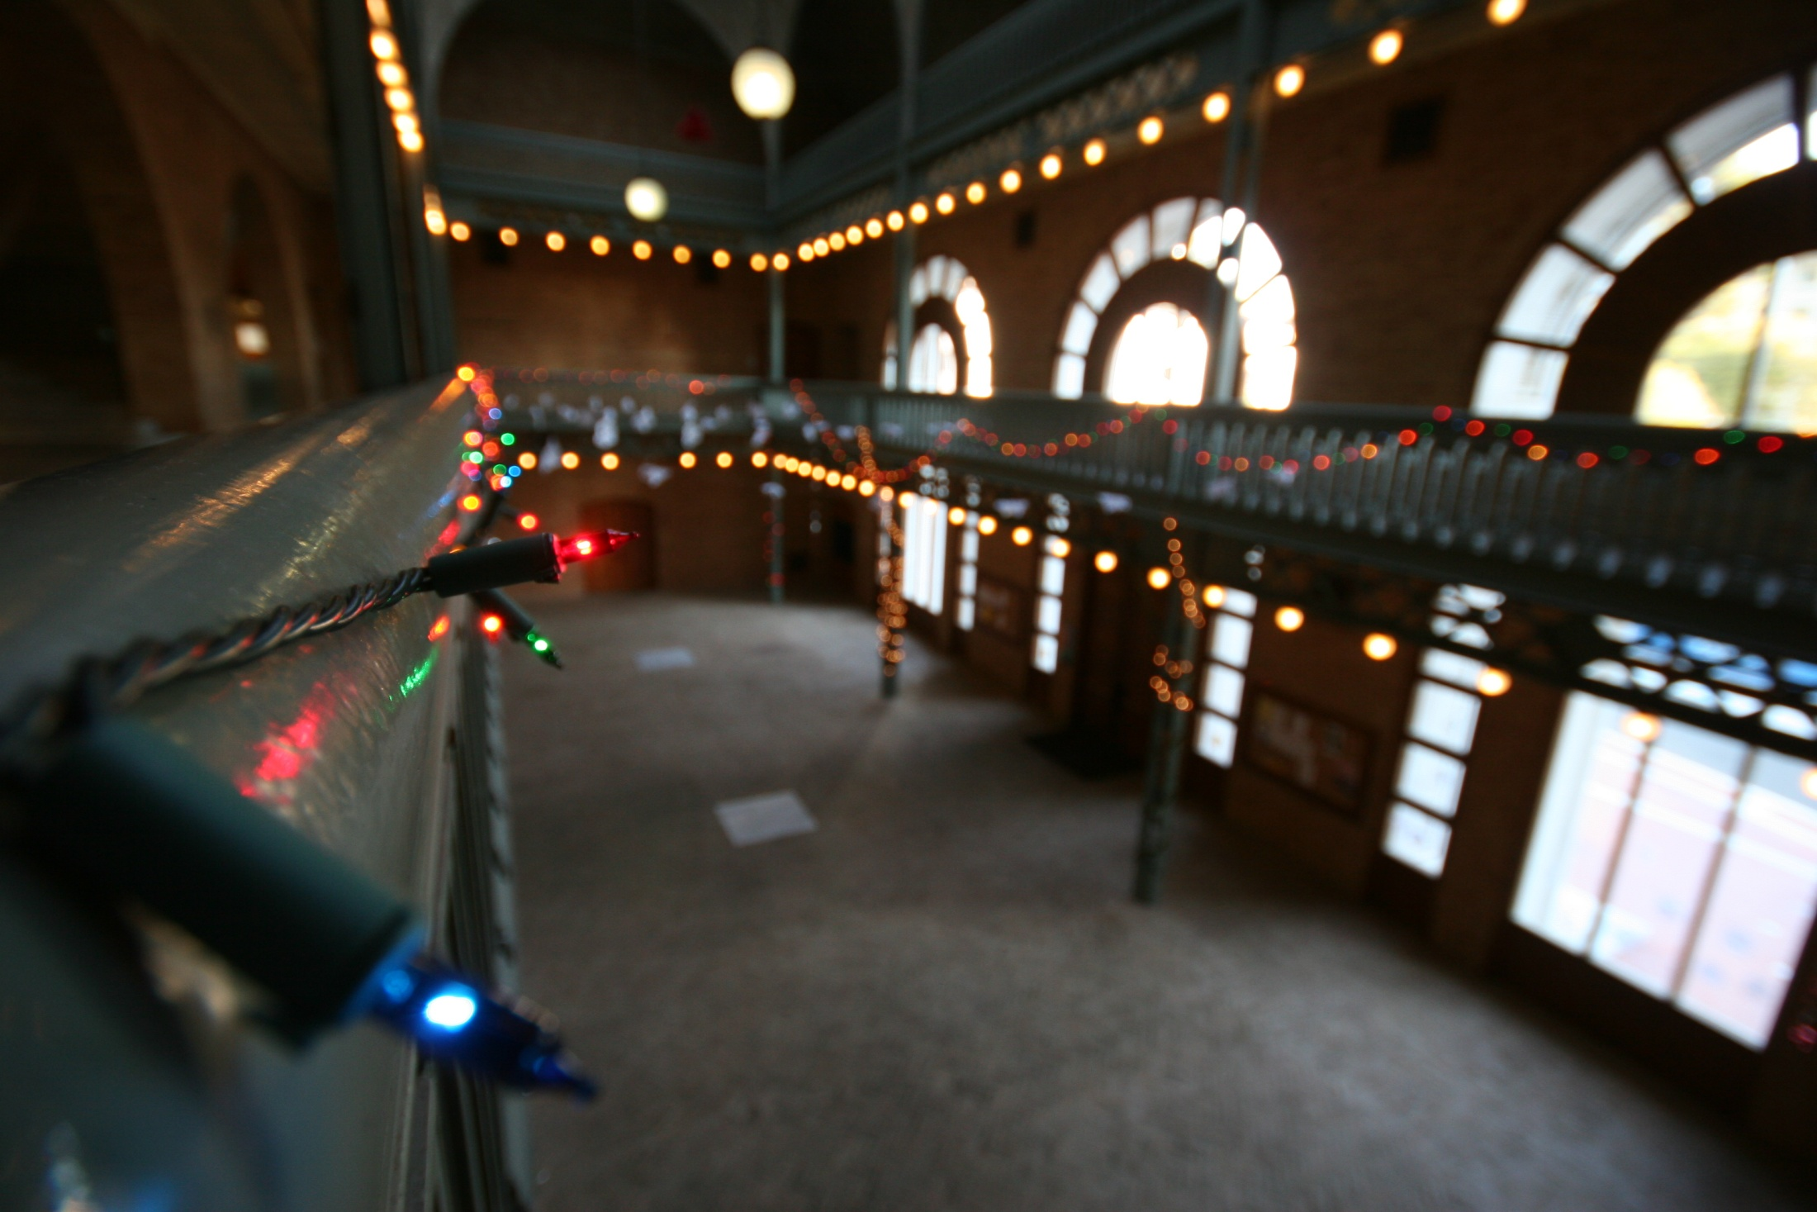
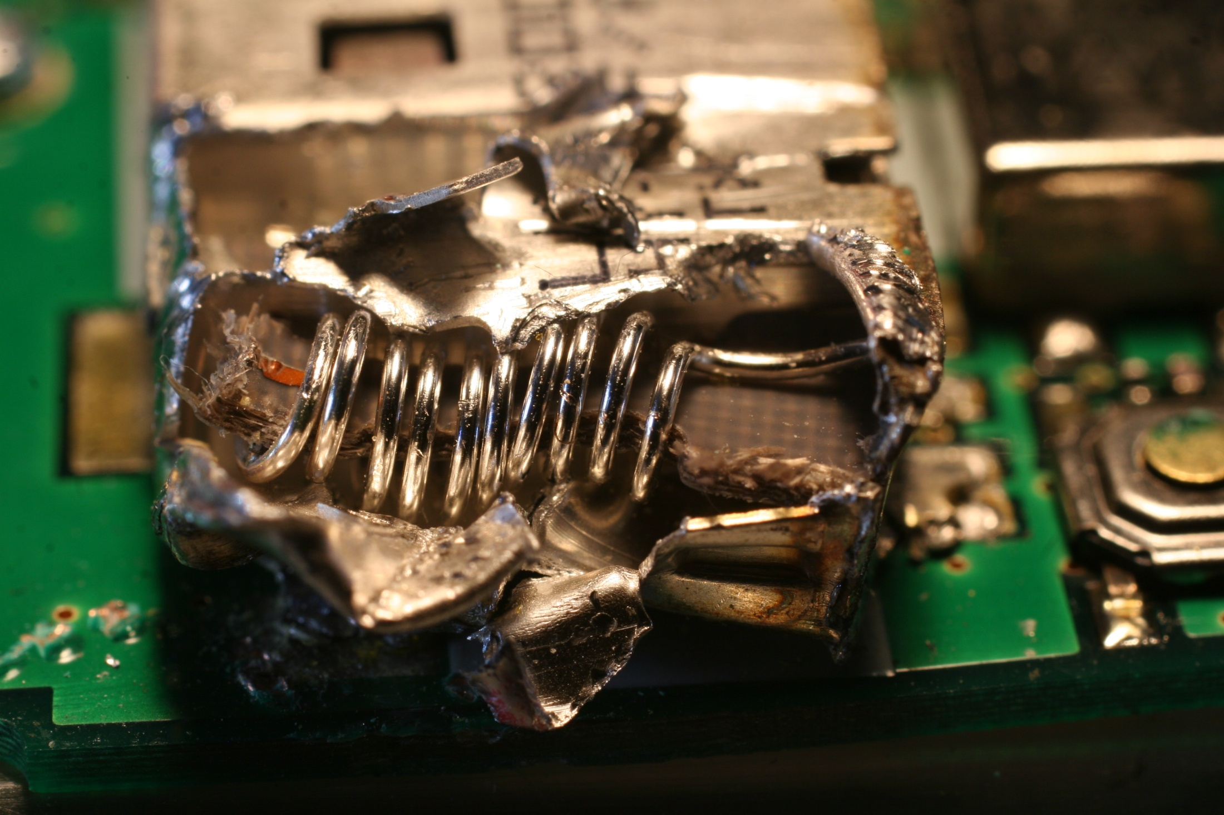
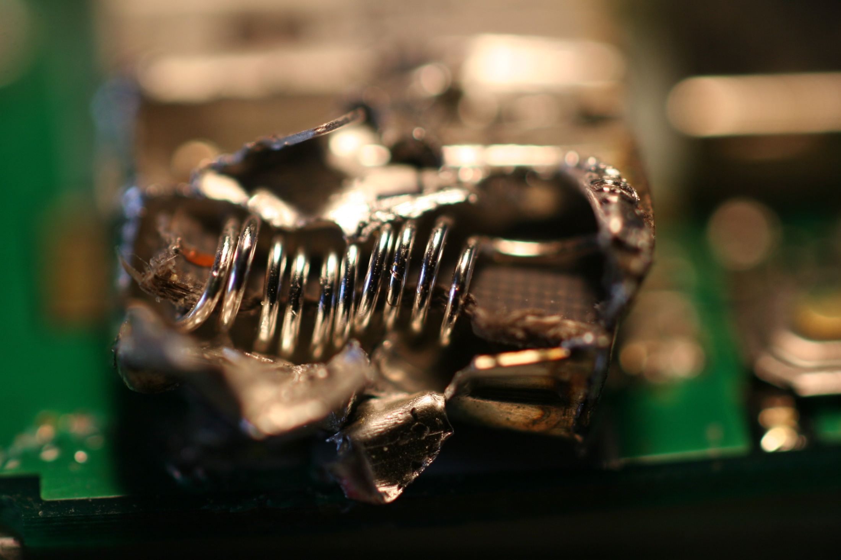
Landscape/scenery
Macro
Architecture
Small depth of field
Uses of large depth of field

Slide 13
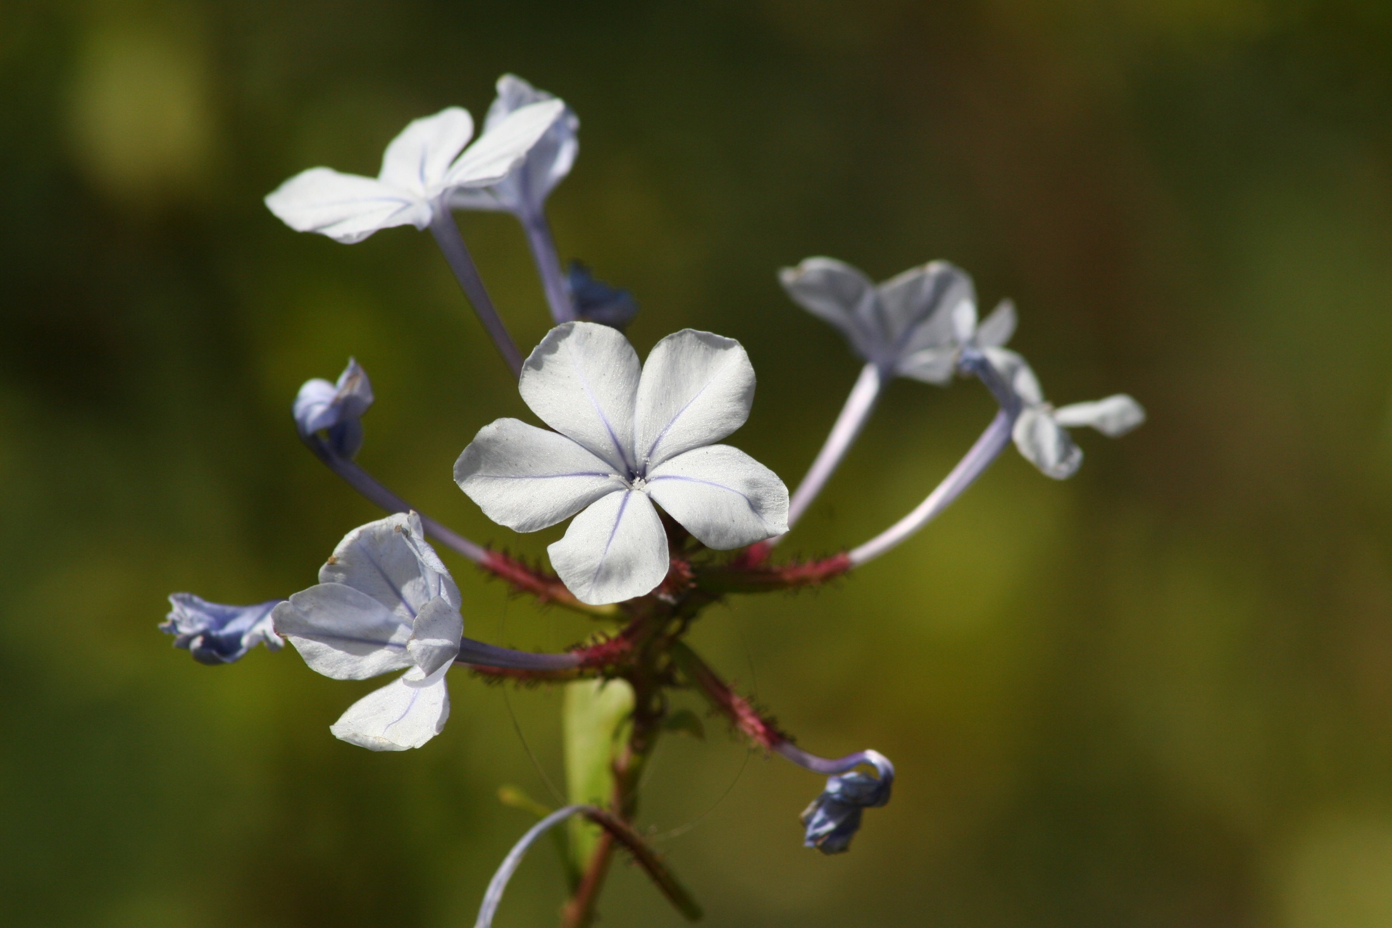
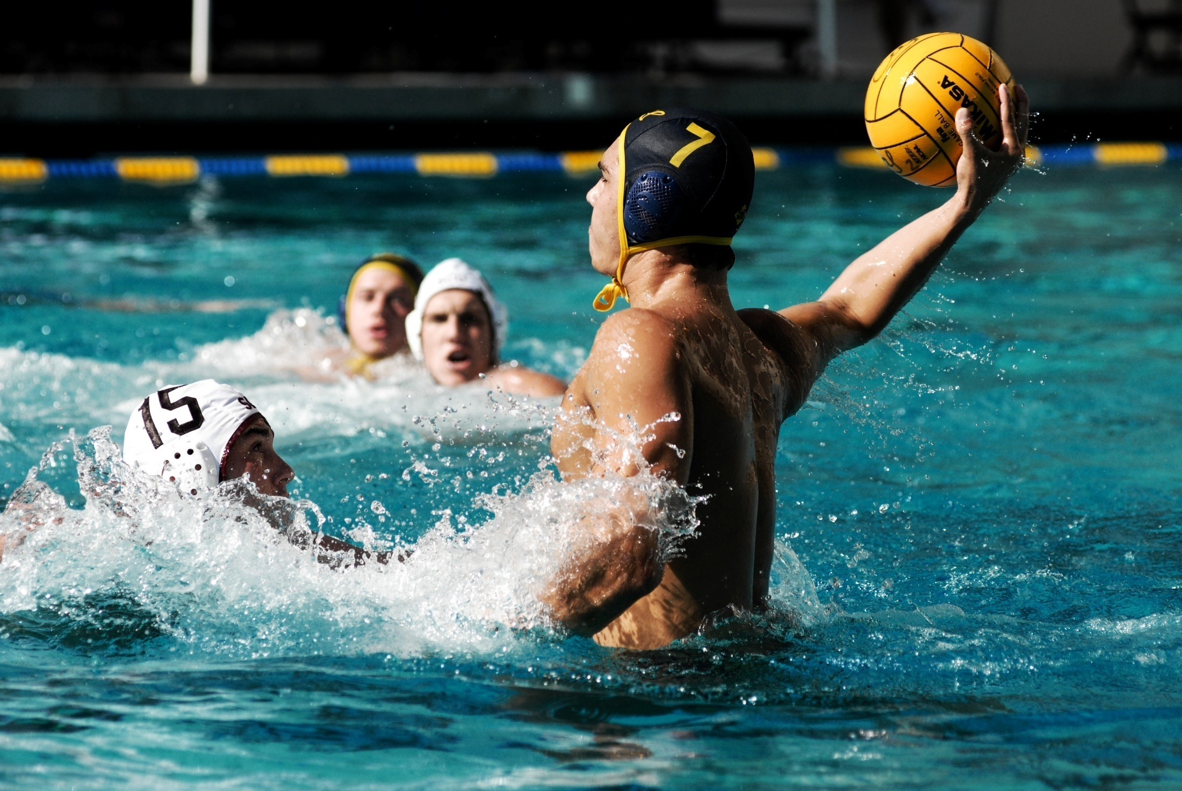
Portraits
Isolation
Sports
Flowers
Uses of small depth of field

Slide 14
