Slide 1
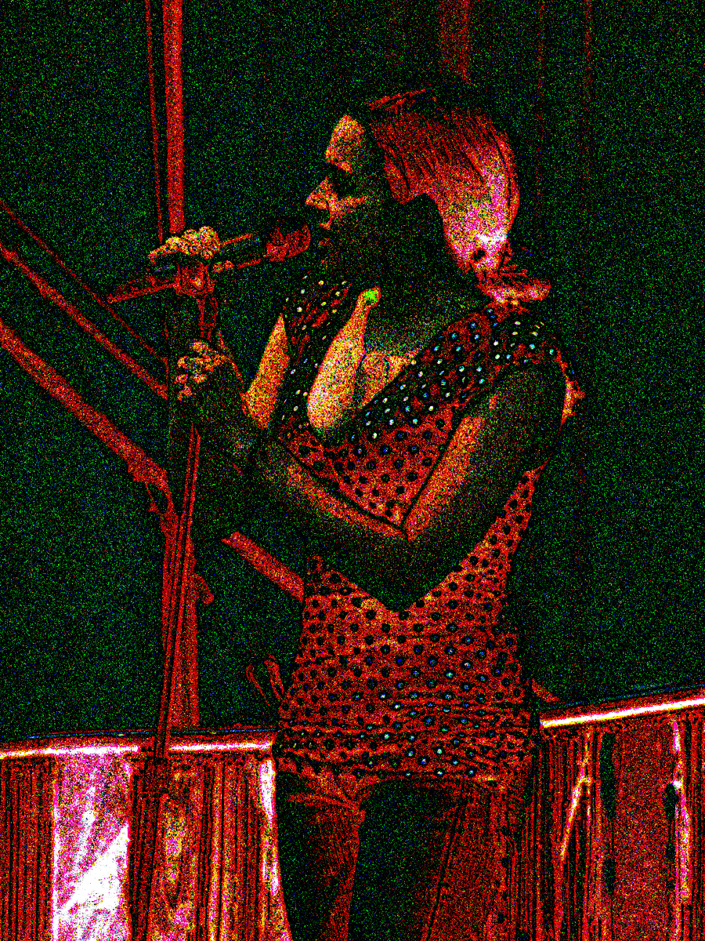
Digital Photography DeCal
EECS98/198
Nathan Yan
About this course
-Technology of Camera Systems
-Photographic Technique
-Digital Lightroom
About Me
^-doesn’t know anything about what he’s talking about
About You
In case you were wondering, this is the noise signature of an image, inverted

Slide 2
How it works
All cameras, film or digital, work the same:
Photons are projected onto a photo-sensitive plane which records the light information

Slide 3
How it works
By confining light to only photons which pass through a certain point, we begin to resolve “detail”
Image processor

Slide 4
History of Camera Development
Many pinhole-type cameras dating back to the 11th century
Joseph Niépce recorded the first photograph in 1826, using a photo-sensitive silver/chalk mixture
Development of recording mediums more responsive to light: wet plates, dry plates
George Eastman introduces photographic film in 1885, and debuts the “Kodak” camera in 1888 – a cheap and easy to operate camera that began to popularize cameras
Oskar Barnack developed the Leica camera in 1925, which popularized 35mm film standard
Ihagee introduced the first single-lens reflex camera, Exakta, in 1933, allowing photographers to view image “through the lens”
Auto-focus developed in the Konica C35AF in 1977

Slide 5
History of Digital Camera Development
Began with charged couple device (CCD) cameras that recorded to analog media
Steve Sasson produced the first for Kodak in 1973
Solid state CCD that recorded output onto cassette tape
Resolution: 10,000 pixels, or 0.01 megapixels
First practical use in 1984, for journalism
Canon RC-701 recorded images onto “video floppies”
During 1984 Olympics images could be transmitted via telephone lines, and image quality was acceptable for newsprint
JPEG image compression standard introduced in 1988
First true digital camera: Fuji DS-1P debuted in 1988, recording a computerized image file to onboard memory
First camera with live image feed to LCD: Casio QV-10 in 1995
First “professional” digital SLR camera natively designed: 2.74MP Nikon D1 in 1999
First affordable “consumer” digital SLR: 6MP Canon Digital Rebel 300D in 2003 - $1000

Slide 6
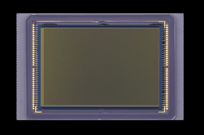
The Imaging Sensor
Input:
Light «photons»
Output:
Electrical signals

Slide 7
Si
Si
Si
Si
Si

Slide 8
Bucketloads of Electrons!
Many electrons
Voltage: High
Implication: Many photons detected, bright exposure
Result: bright image
Few electrons
Voltage: Low
Implication: Few photons detected, dark exposure
Result: dark image
Max electrons
Voltage: Max
Implication: Max photons detected, brightest exposure
Result: White image
No electrons
Voltage: Zero
Implication: No photons detected, darkest exposure
Result: Black image

Slide 9
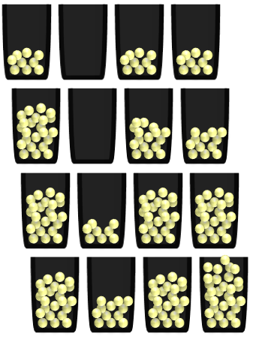
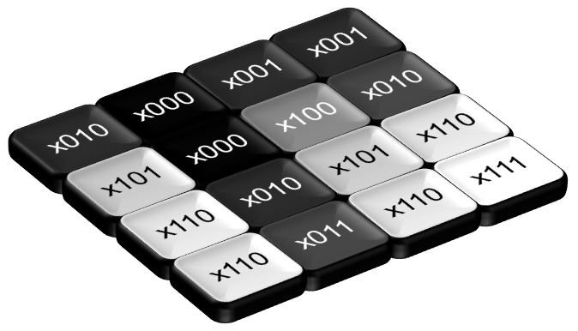
Shutter speed
Aperture
Amplified electrical signal
Si
Voltage Reading
Photons
Signal Amplification
Si
Amplifier
Analog-to-Digital Converter
Si
Quantum efficiency
Electrical signal
Photoelectrons
Accumulated charge
101010100100
Photons
Digital representation of electrical signal
Electrons
Voltage Signal
Image file
Digital Multiplication
Image Brightness
Image processor

Slide 10
Problem: Since the sensor only records light intensity, we can’t differentiate between colors! Thus, imaging sensors only record in black and white
Solution: Color filtering, the most common form being the Bayer filter
?
We know the pixel is bright, but what color is it?
?
?
Sensors
Photo wells

Slide 11
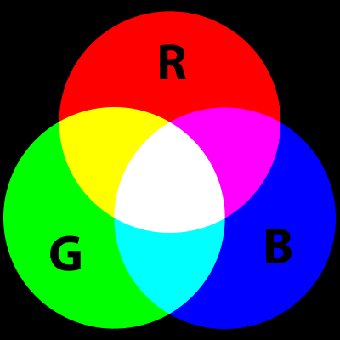
BAYER FILTER
Designates individual photosites to be either red, green, or blue (RGB)
Respective color filters are placed over each photosite
Thus, only the light energy corresponding to that color’s wavelength reaches the sensor
Thus the sensor can interpret the energy recorded at that photosite to be a measure of that certain color
Knowing the intensities of red, green, and blue light, we can derive the actual color

Slide 12
Drawbacks of…
Raw Bayer Output
BAYER FILTER
Color offset
Since each photosite must be designated some color, the Bayer pattern of blue, green, and red photosites if offset, with blue tending towards top-left and red tending towards bottom-right
Loses 2/3 of light information
At each photosite, 2 of 3 colors are filtered out, and light information discarded
Workarounds:
-Expose pictures for 3x time
-not practical for photography
-Demosiac algorithms to interpolate missing 2/3 data
Actual Image
Demosiaced Bayer Output

Slide 13
Ideal
Rate of incoming light is constant
Real life
Rate of incoming light is fluctuating
End of exposure
End of exposure
Photon
rate
Photon
rate
Time
Time
How much fluctuation?
Dictated by Poisson (pwasõ) Distribution
For n total photons in exposure,
standard deviation =
√n

Slide 14
√n, so what?
Variable brightness = noise!
Photons collected = n + √n
If n = 10,000 photons,
Photons collected = 10,000 + √10,000 = 10,000 + 100 photons
10,000 photons
9,900
photons
10,100
photons
9,950
photons
Noise monster One of the photographer’s worst enemies

Slide 15
Proportion of Photon Fluctuation (√(n)/n)
Photons

Slide 16
Proportion of Photon Fluctuation (√(n)/n)
Photons

Slide 17
Proportion of Photon Fluctuation (√(n)/n)
Photons

Slide 18
x001
x001
x010
x000
x100
x010
x110
x000
x101
x101
x111
x010
x110
x110
x011
x110

