Slide 1
Ideal
Rate of incoming light is constant
Real life
Rate of incoming light is fluctuating
End of exposure
End of exposure
Photon
rate
Photon
rate
Time
Time
How much fluctuation?
Dictated by Poisson (pwasõ) Distribution
For n total photons in exposure,
standard deviation =
√n

Slide 2
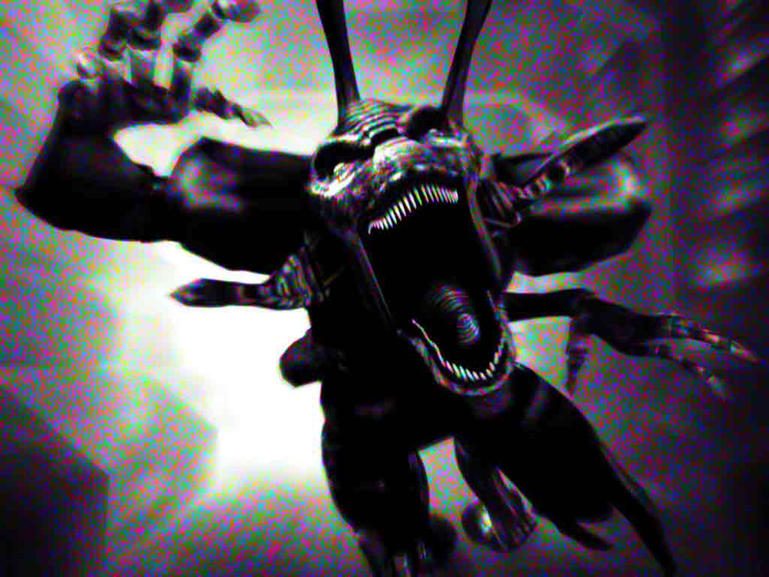
√n, so what?
Variable brightness = noise!
Photons collected = n + √n
If n = 10,000 photons,
Photons collected = 10,000 + √10,000 = 10,000 + 100 photons
10,000 photons
9,900
photons
10,100
photons
9,950
photons
Noise monster One of the photographer’s worst enemies

Slide 3
Proportion of Photon Fluctuation (√(n)/n)
Photons

Slide 4
Proportion of Photon Fluctuation (√(n)/n)
Photons

Slide 5
Proportion of Photon Fluctuation (√(n)/n)
Photons

Slide 6
Proportion of Photon Fluctuation (√(n)/n)
Photons

Slide 7
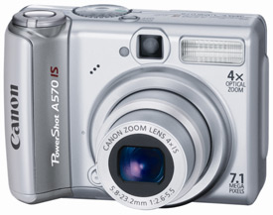
Canon A570IS
7.1 Megapixels
1/2.5” sensor
5.76 x 4.29mm (24.7mm²)
Density: 3.48 μm²/pixel
Proportion of Photon Fluctuation (√(n)/n)
Photons

Slide 8
ISO100
ISO200
ISO400
Canon A570IS
7.1 Megapixels
1/2.5” sensor
5.74 x 4.3mm (24.7mm²)
Density: 3.48 μm²/pixel
1600
800
400
200
100
ISO800
ISO1600
images: dcresource.com

Slide 9
ISO100
ISO200
ISO400
Fuji F30
6.1 Megapixels
1/1.7” sensor
7.7 x 5.77mm (44.4mm²)
Density: 7.27 μm²/pixel
1600
800
400
200
100
ISO800
ISO1600
images: dcresource.com

Slide 10
ISO100
ISO200
ISO400
Canon 30D
8.2 Megapixels
APS-C sensor
22.5 x 15mm (337.5mm²)
Density: 41.16 μm²/pixel
1600
800
400
200
100
ISO800
ISO1600
images: dcresource.com

Slide 11
F30
30D
A570IS
6.1 Megapixels
7.7 x 5.77mm (44.4mm²)
Density: 7.27 μm²/pixel
8.2 Megapixels
22.5 x 15mm (337.5mm²)
Density: 41.16 μm²/pixel
7.1 Megapixels
5.76 x 4.29mm (24.7mm²)
Density: 3.48 μm²/pixel
F30
30D
A570IS

Slide 12
Proportion of Photon Fluctuation (√(n)/n)
ISO

Slide 14
Making matters worse, circuitry must occupy some space between each photowell – the more photowells, the more space circuitry takes up.

Slide 15
Summary
More pixels, smaller sensor => less light per pixel => more noise
Less pixels, bigger sensor => more light per pixels => less noise
In theory, the biggest sensor with the least pixels will give us the best image, in terms of noise.
A 1-pixel sensor would be ideal.
With 1 pixel, we’d have low noise but no detail.
Many pixels => High detail, high noise
Few pixels => Low detail, low noise
The “Megapixel Myth”: Detail vs. Noise

Slide 16
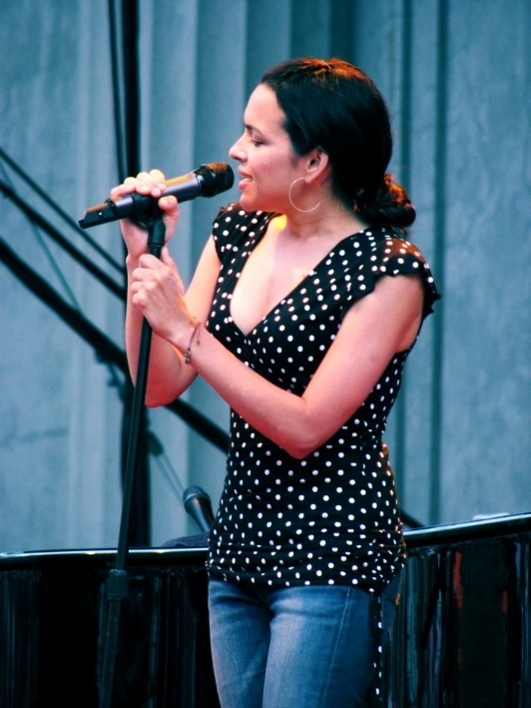
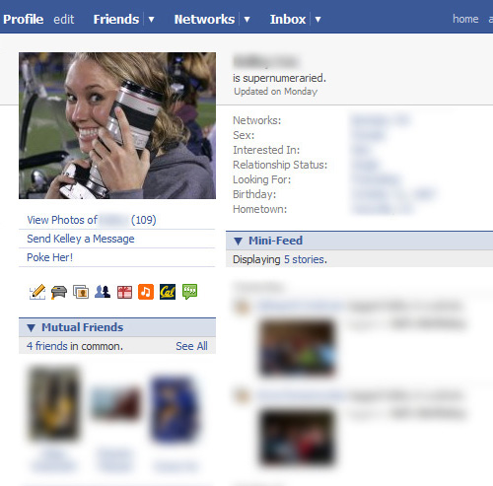
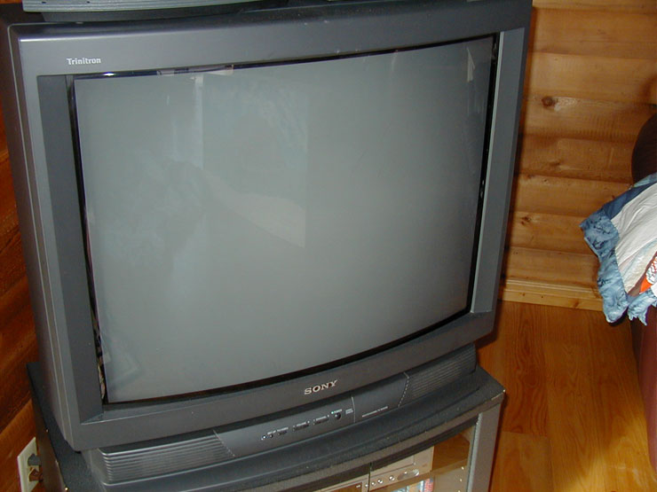
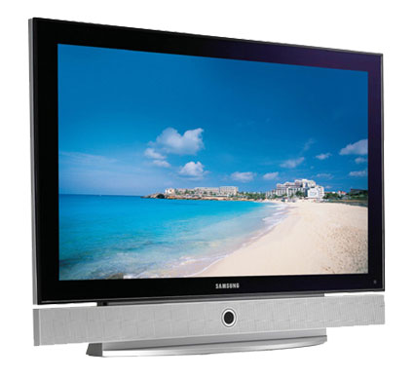
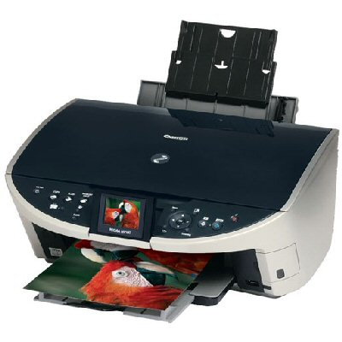
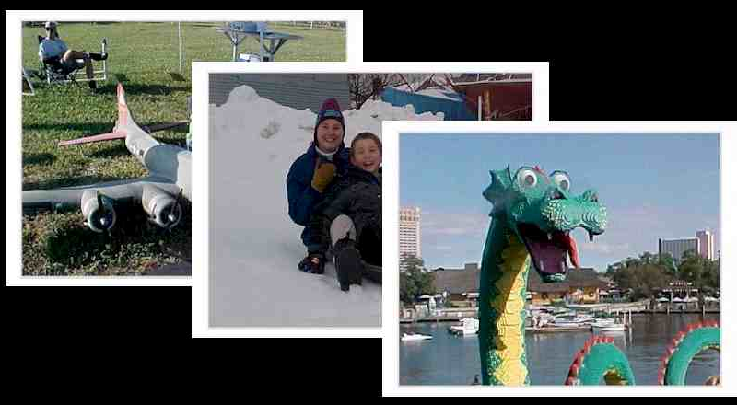
Megapixels: Detail vs. Noise
How many pixels do we need?:
Facebook profile picture:
4x6 studio print at 300dpi:
5x7 studio print at 300dpi
Standard VGA TV:
1080p HDTV:
1280x1024 19” LCD monitor:
8.5x11in, 300dpi magazine spread:
8x10 inkjetprint at 200dpi:
10x14in, 150dpi full-page spread in Daily Cal:
Giant 20x30in poster print at 150dpi:
0.03 MP
2.16 MP
3.15 MP
0.35 MP
2.07 MP
1.31 MP
8.42 MP
3.20 MP
3.15 MP
13.5 MP
If you only look at pictures on the computer, 2-3MP
If you make non-poster-size prints (4x6, 5x7, 8x10), 3-4MP
More pixels beyond this don’t add detail, and contribute to greater noise

