Slide 1
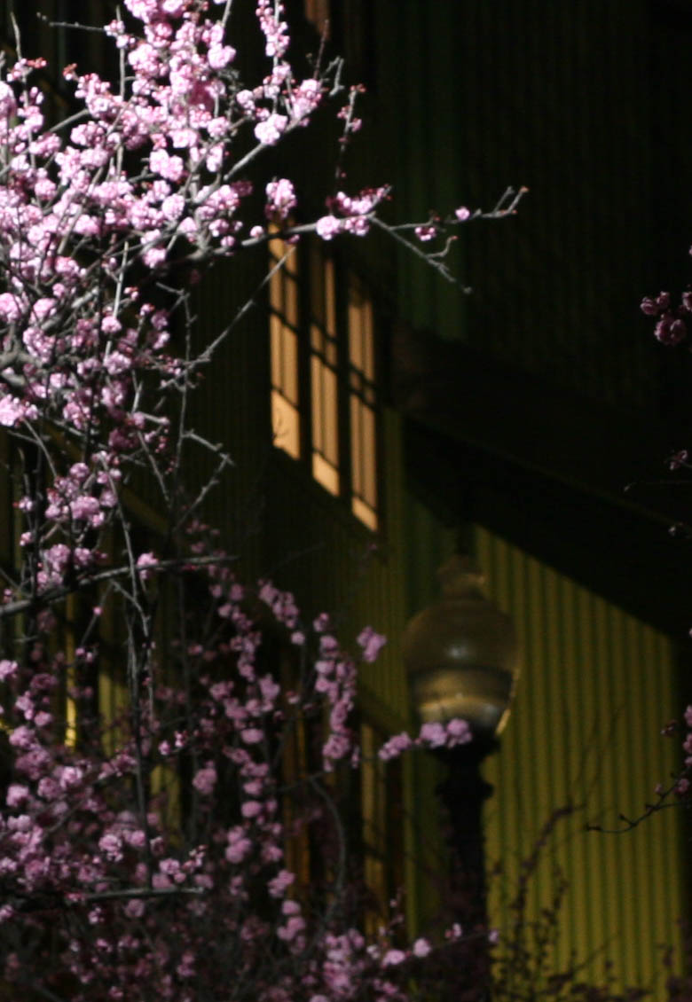
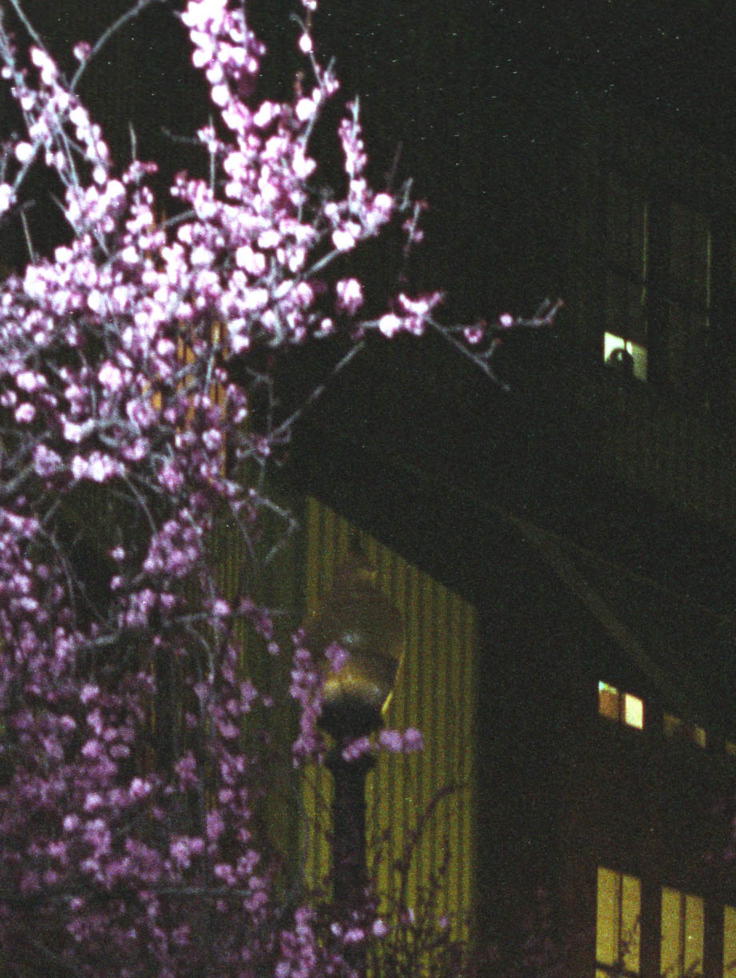
Canon 20D vs. Film
ISO400

Slide 2
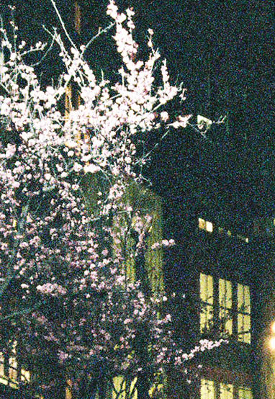
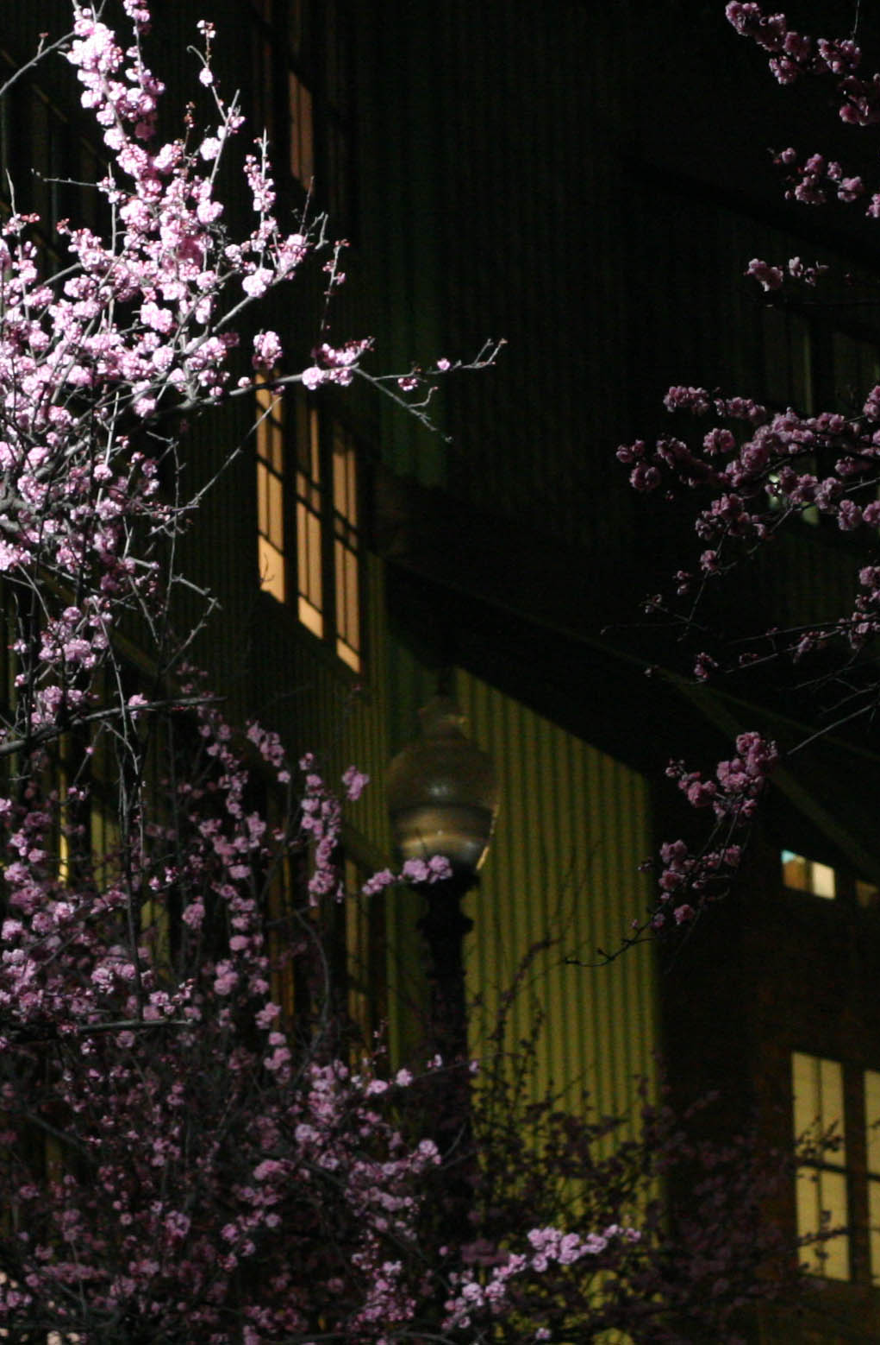
Canon 20D vs. Film
ISO1600

Slide 3
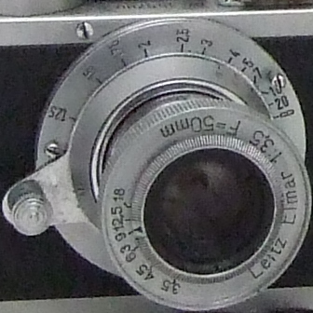
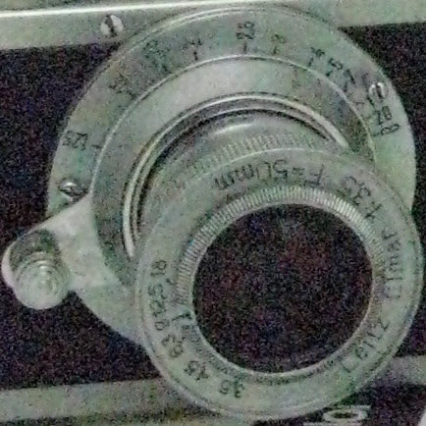
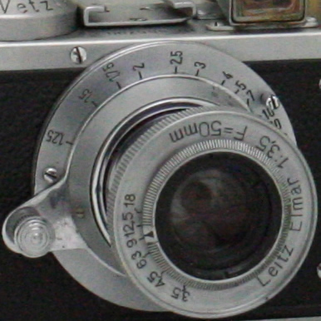
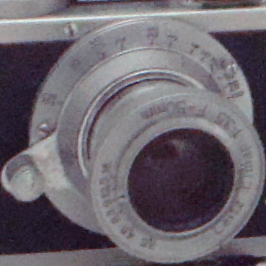
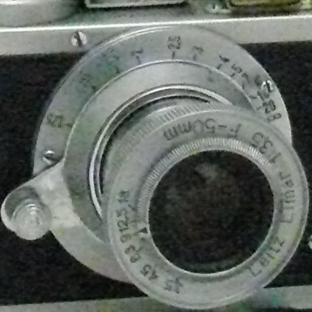
Fuji F30
44.4mm²
7.27 μm²/pixel
Canon G7
38.2mm²
3.82 μm²/pixel
Canon Rebel XT
328.56mm²
41.07 μm²/pixel
Panasonic FZ50
38.2mm²
3.78 μm²/pixel
Sony W80
24.7mm²
3.42 μm²/pixel

Slide 4
Random Noise
Fluctuation in light input (random distribution of photons)
Chrominance Noise
Variation in color
Luminance Noise
Variation in brightness

Slide 5
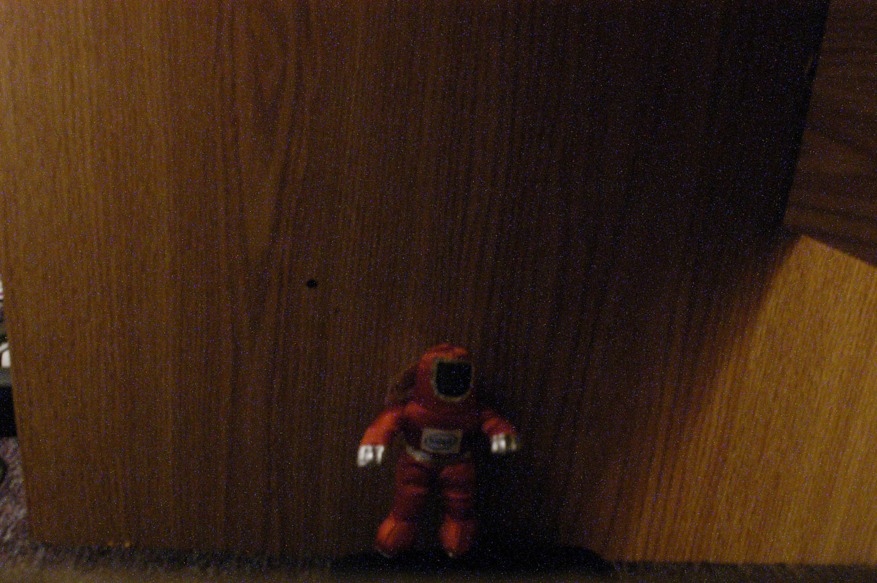
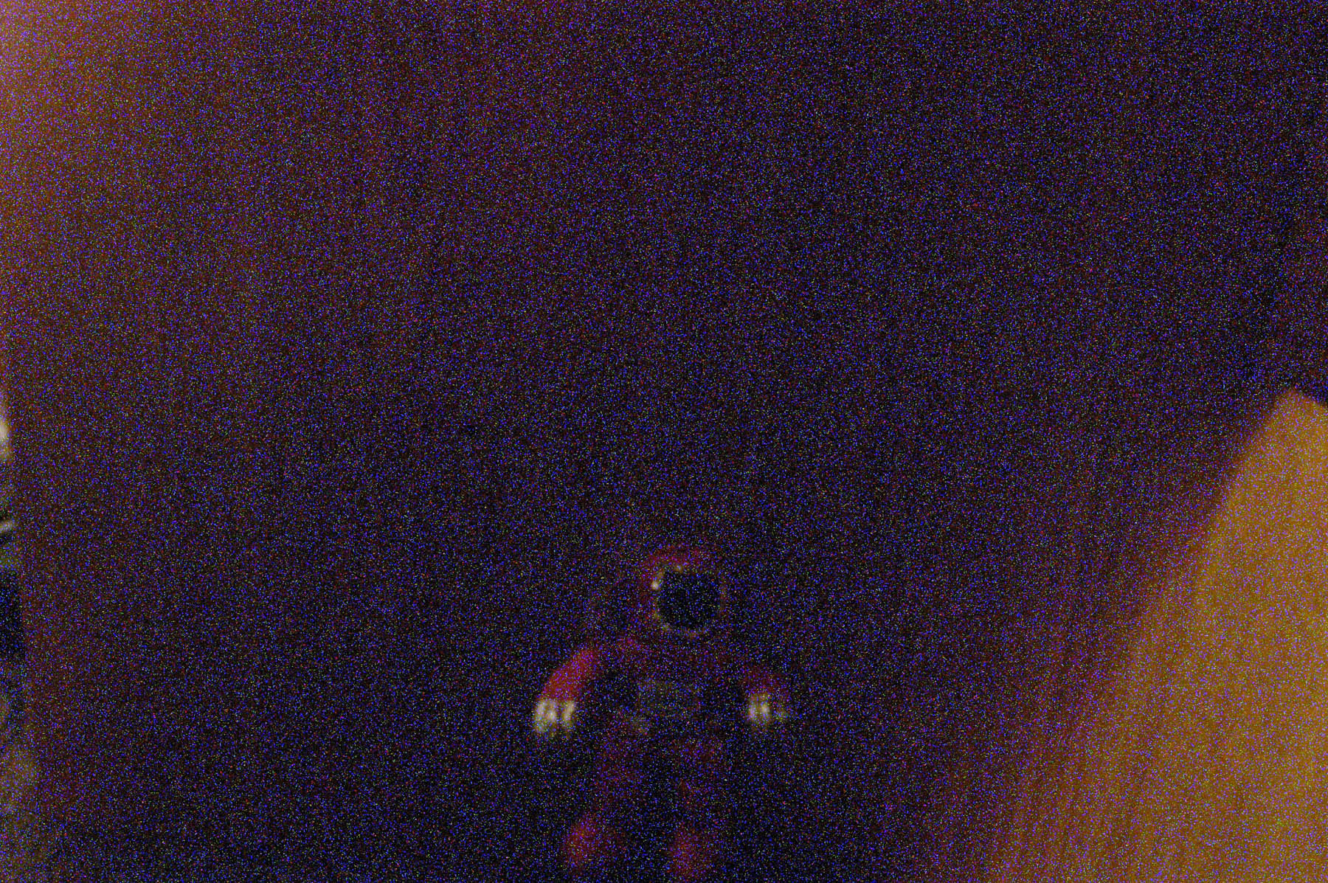
Fixed Pattern Noise
-Consistently reproducible noise
-Caused by electronics, sensor defects, heat
-Manifested as “hot pixels” or luminance anomalies
-Since noise is reproducible (non-random), easily fixed by dark frame subtraction

