Slide 1
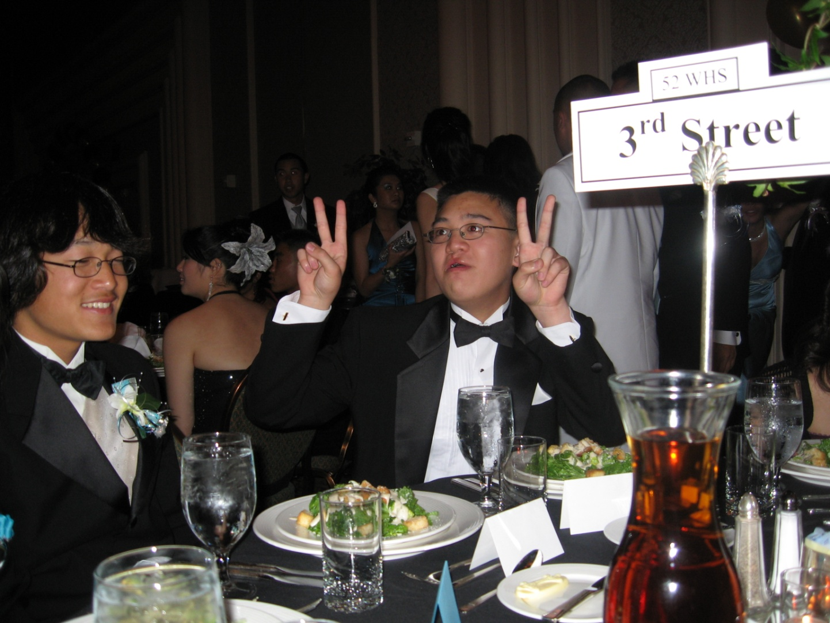
Flash is bad!

Slide 2
“Available light”
Rate of incoming light is constant
End of exposure
Photon
rate
Time

Slide 3
“Low light”
Very few photons collected
End of exposure
Photon
rate
Time

Slide 4
“Direct Flash”
Flash shoots light at subject, photons bounce back to camera
End of exposure
Photon
rate
Time

