Slide 1
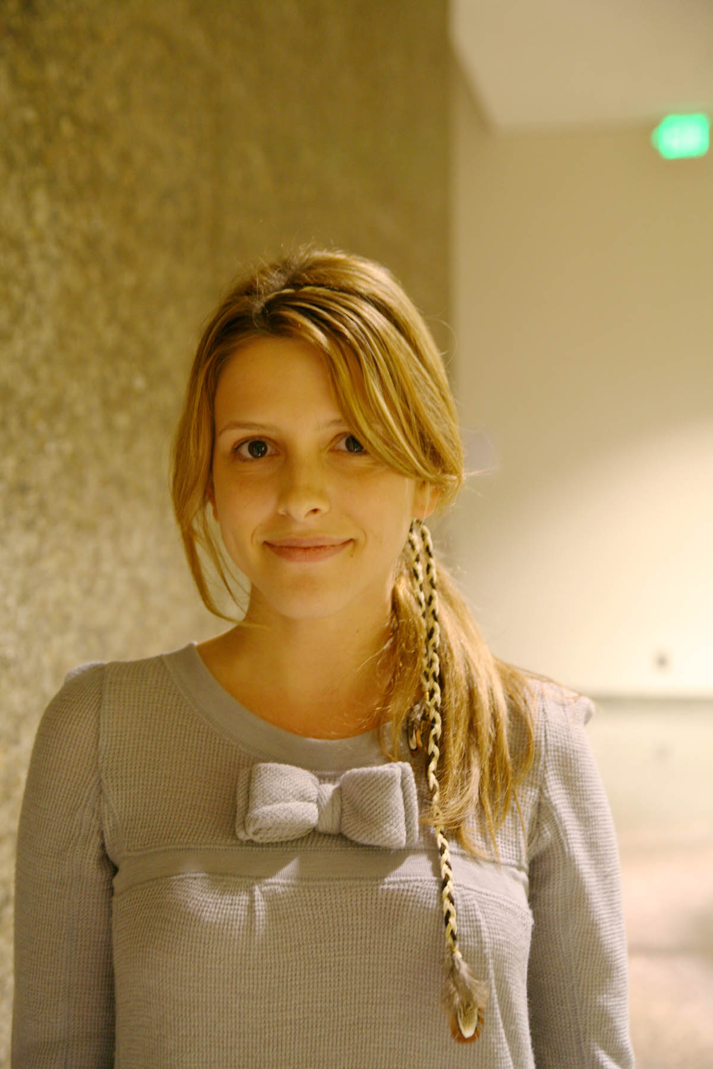
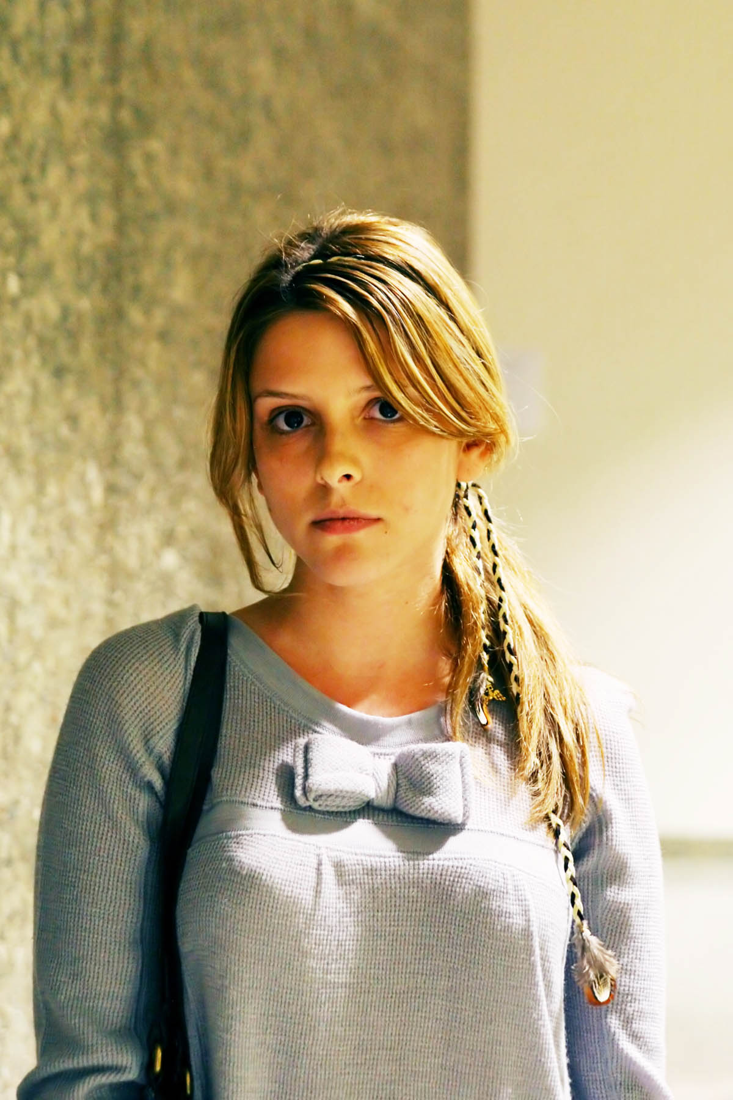
Exposure and Dynamic Range
Low contrast | High Contrast

Slide 2
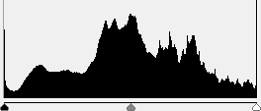
Histogram: plots pixels according to brightness: L-R, Dark-Bright
Low contrast: Most pixels in middle, few very dark (shadows) or very bright (highlights) areas.
Result: Flat, boring picture. No defining characteristics.

Slide 3
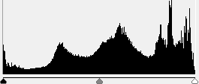
Histogram: plots pixels according to brightness: L-R, Dark-Bright
High contrast: More pixels toward edge, in very dark (shadows) or very bright (highlights) areas.
Result: Interesting, dynamic picture. Sharply defined characteristics.

Slide 4
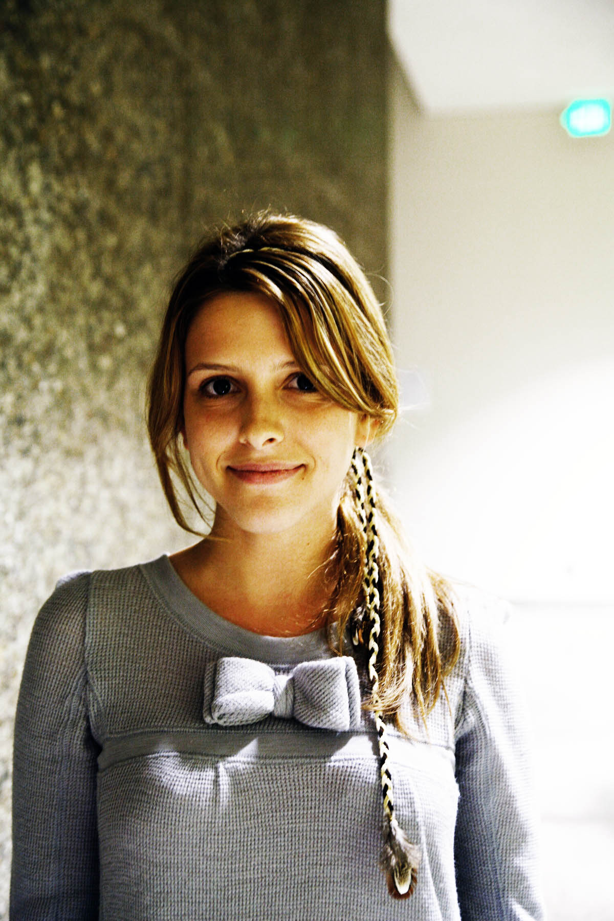
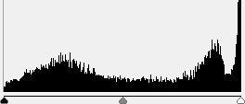
Histogram: plots pixels according to brightness: L-R, Dark-Bright
Low contrast: Most pixels in middle, few very dark (shadows) or very bright (highlights) areas.
Result: Flat, boring picture. No defining characteristics.
However, low contrast can always be edited into a high contrast image

Slide 5
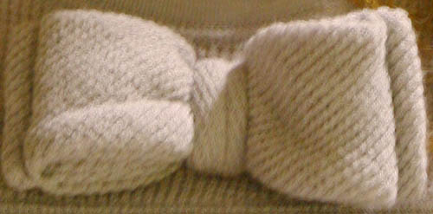
Low contrast
High contrast has caused this area to be completely white, destroying all detail. It is impossible to get this detail back – this is known as a “blown highlight”.
High contrast

Slide 6
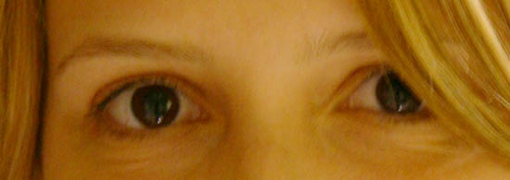
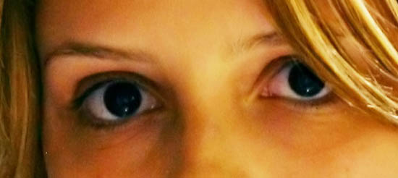
Low contrast
High contrast has caused this area to be completely black, destroying all detail. It is impossible to get this detail back – this is known as a “crushed shadow”.
High contrast

Slide 7
Shadows and Highlights
Dynamic
Range
If the electron count is below a certain threshold, it is just recorded as black. So if there aren’t enough photons, all the detail in those pixels is lost.
When the photowell is full, a highlight occurs. No photons after this are recorded, so all detail for these pixels are lost.

Slide 8
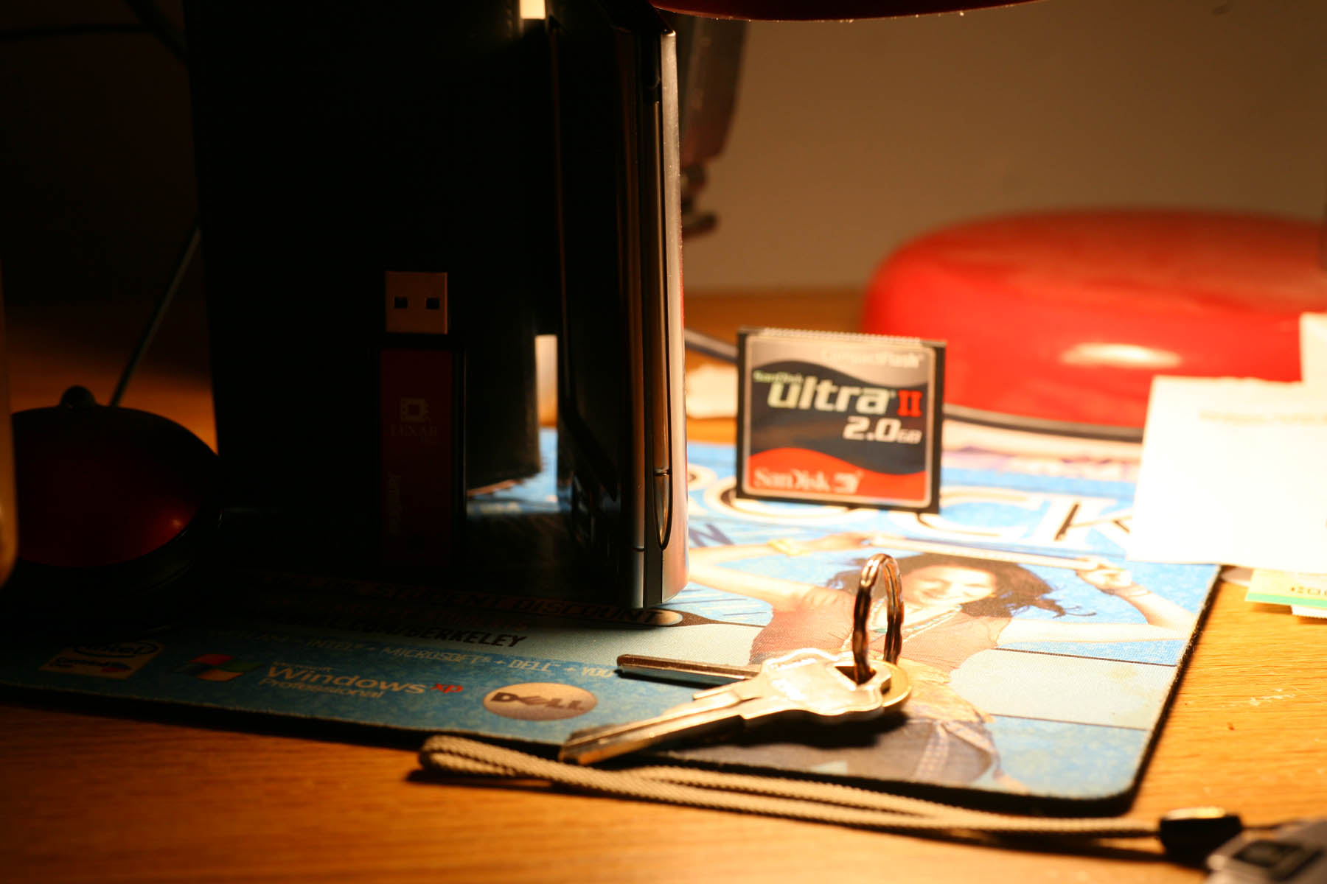
Large dynamic range: very bright and very dark areas in same scene

Slide 9
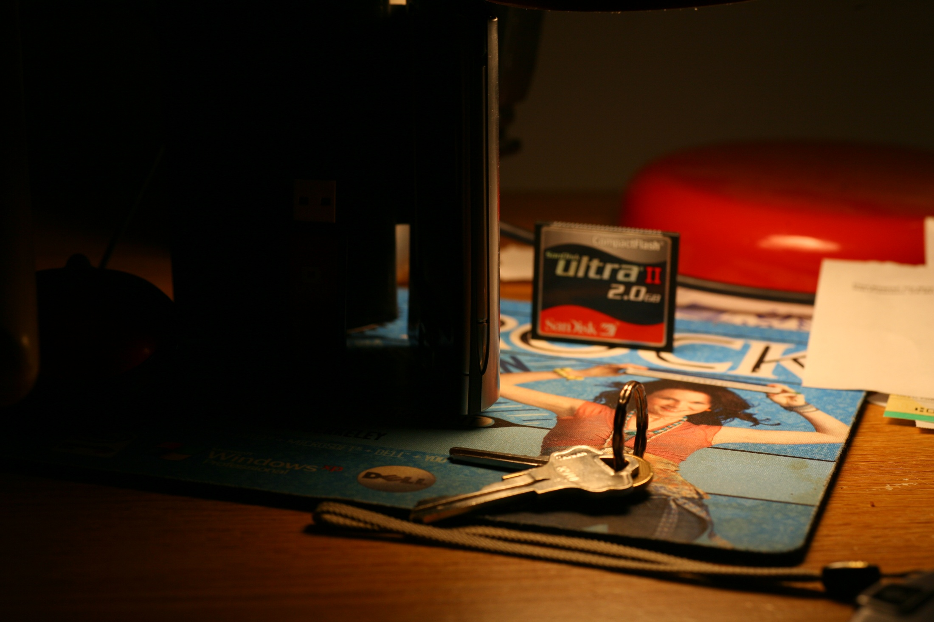

Slide 10
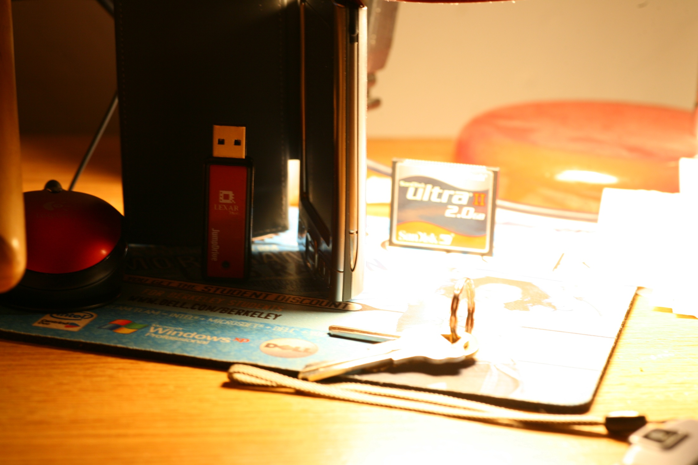

Slide 12
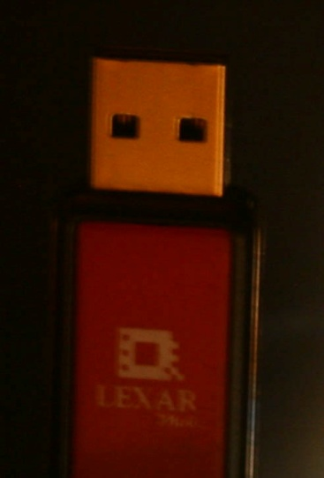
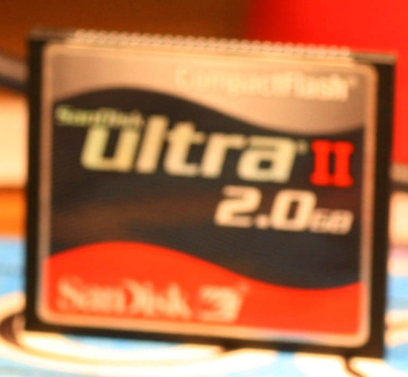
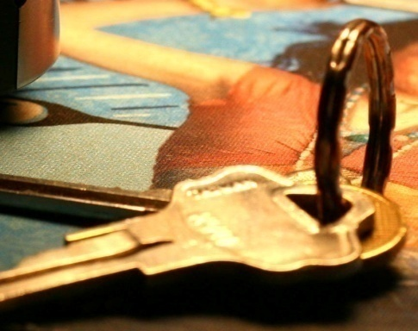
The camera has a limited dynamic range. Thus it can only capture a certain portion of the total dynamic range of the scene.

